Slide 1
Python網站框架開發助理證書(CT290DS008) Group Project : 黃國雄(22)

Slide 2
Project - Introduction
Help a friend establish an online presence for property website
Provide a centralized, easy‑to‑use platform for buyers (customers) and sellers (salespersons)
Use Django and full‑stack web development
Build a modern search and filter features
Explore UI/UX design and branding in a practical context

Slide 3
Issues Faced During Development
Limited resources (time, manpower)
Learning curve with Django framework and DB migrations
Data consistency problems (importing property records, cleaning formats)
UI/UX challenges (responsive design, compact layouts, sliders)
Debugging template and namespace errors in Django
Balancing backend functionality with polished frontend design

Slide 4
How to Overcome Issues
Use UML (Class Diagram → Structure, Use Case Diagram→ Functionality, Sequence Diagram → Interaction) into clear milestones with achievable goals
Use robust data validation scripts for clean imports (Individual Assignment)
Apply Bootstrap grid and CSS refinements for responsive layouts
Iteratively test and refine search filters and sliders
Seek AI / community support for Django troubleshooting

Slide 5
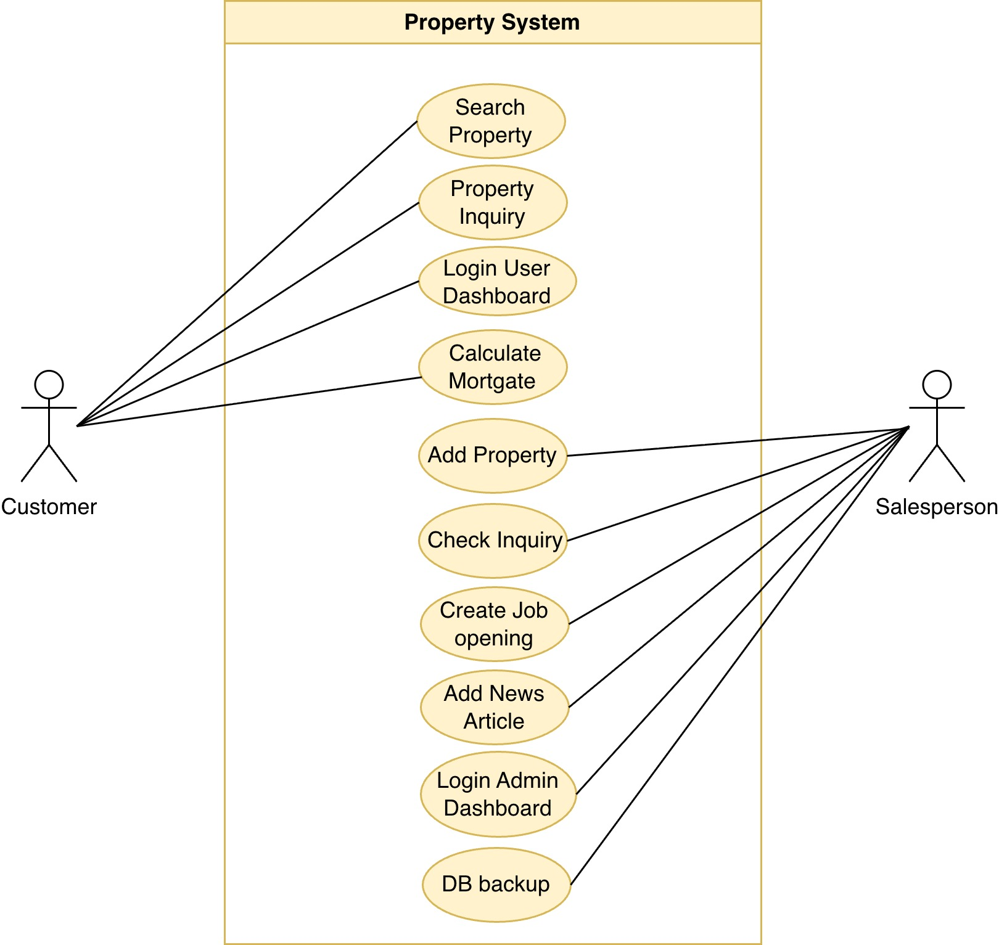
Use Case Diagram

Slide 6
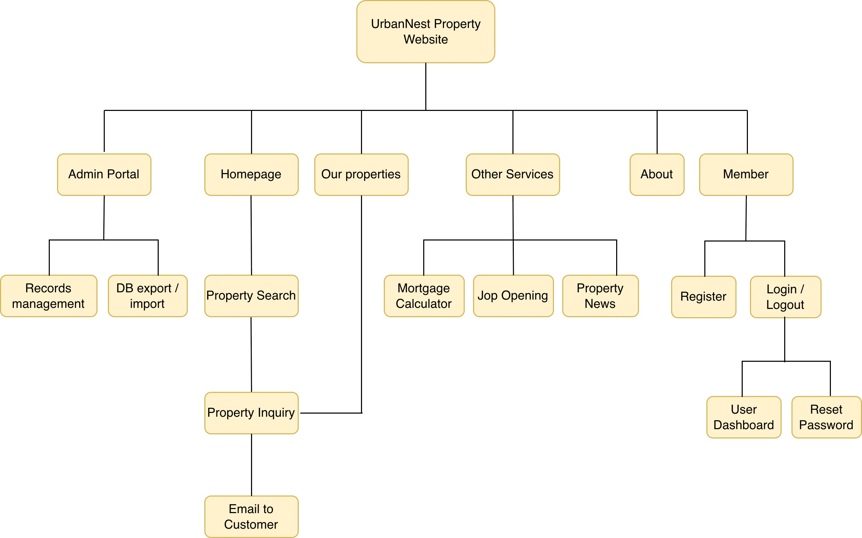
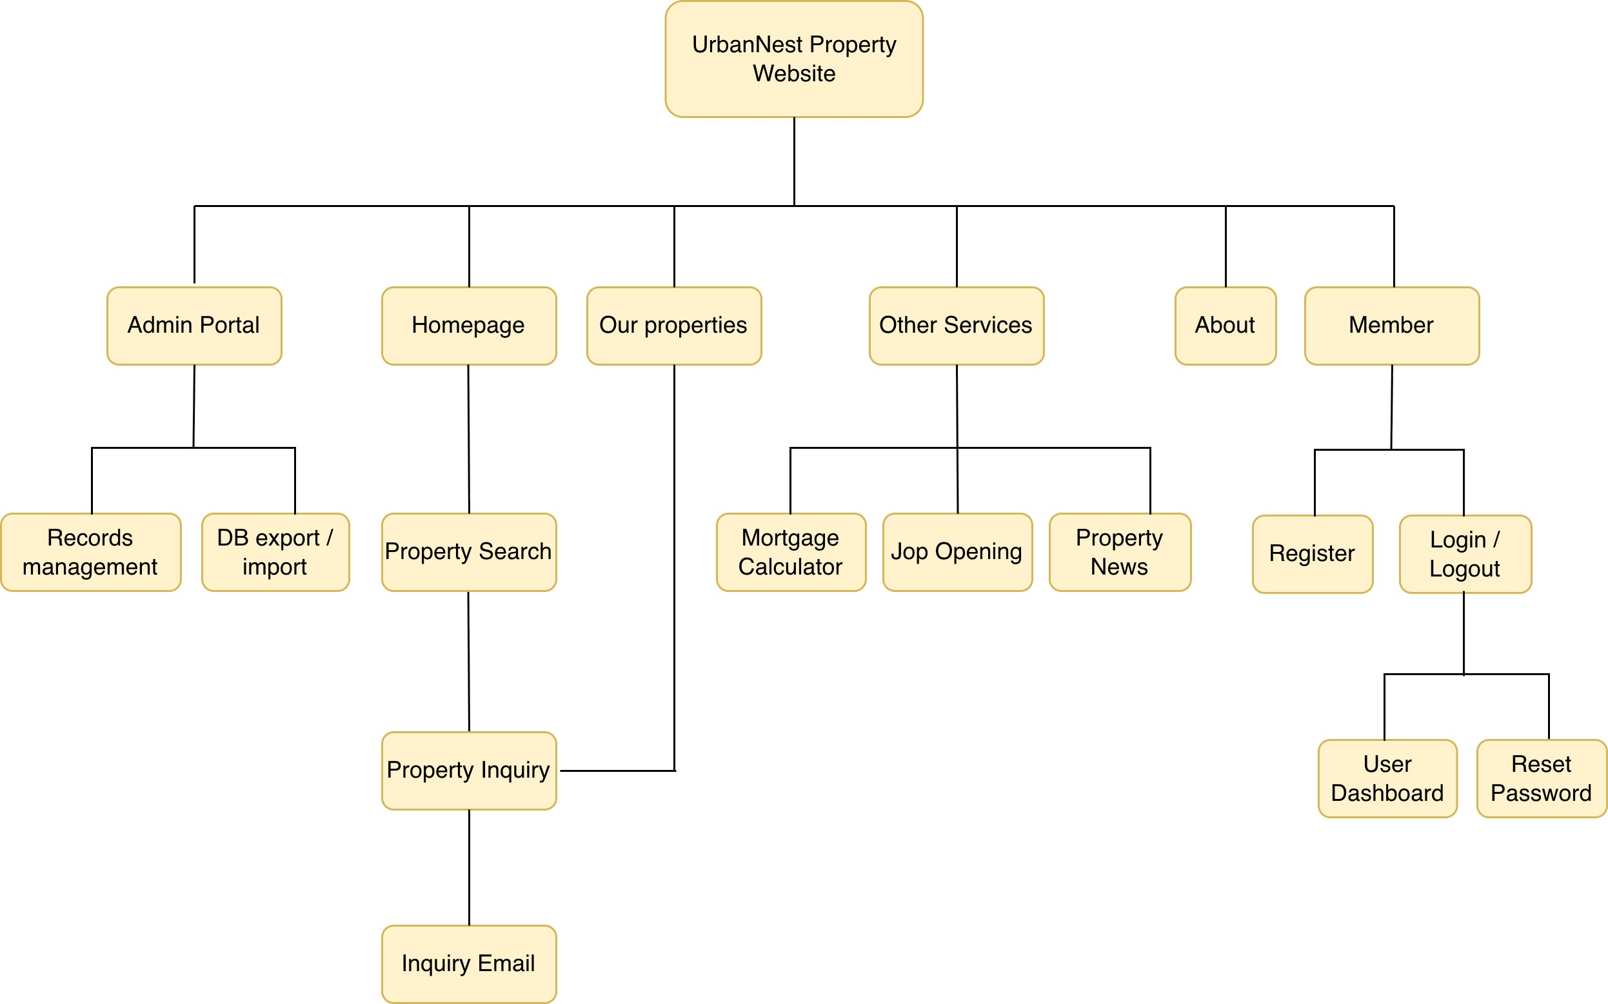
Web Site Structure Diagram

Slide 7
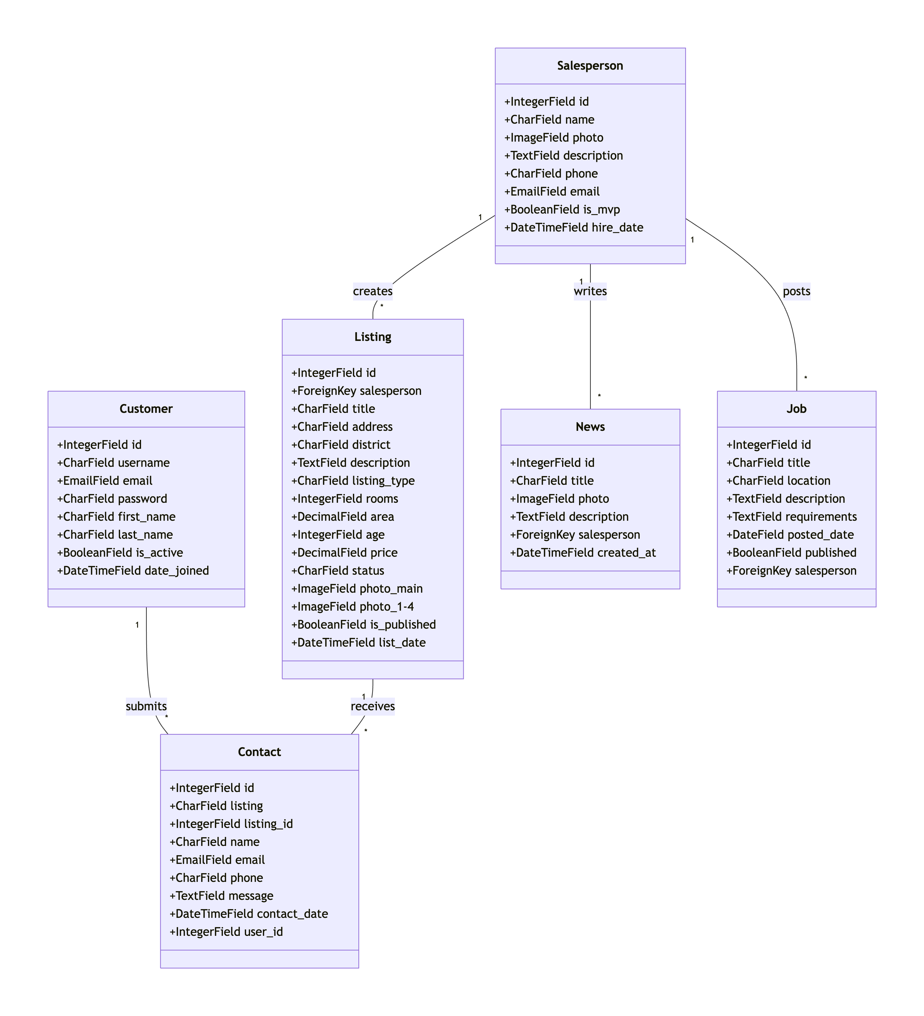
Class Diagram
Description:
Customer: User account fields (id, username, email, etc.)
Salesperson: Agent profile fields (name, photo, contact, etc.)
Listing: Property detail fields (title, address, price, photos, etc.)
Contact: Inquiry form fields (name, email, message, etc.)
News: Article fields (title, description, photo, etc.)
Job: Job posting fields (title, location, description, etc.)
Relationships: Salesperson creates Listings, News, and Jobs; Customer makes Contacts; Listing receives Contacts.

Slide 8
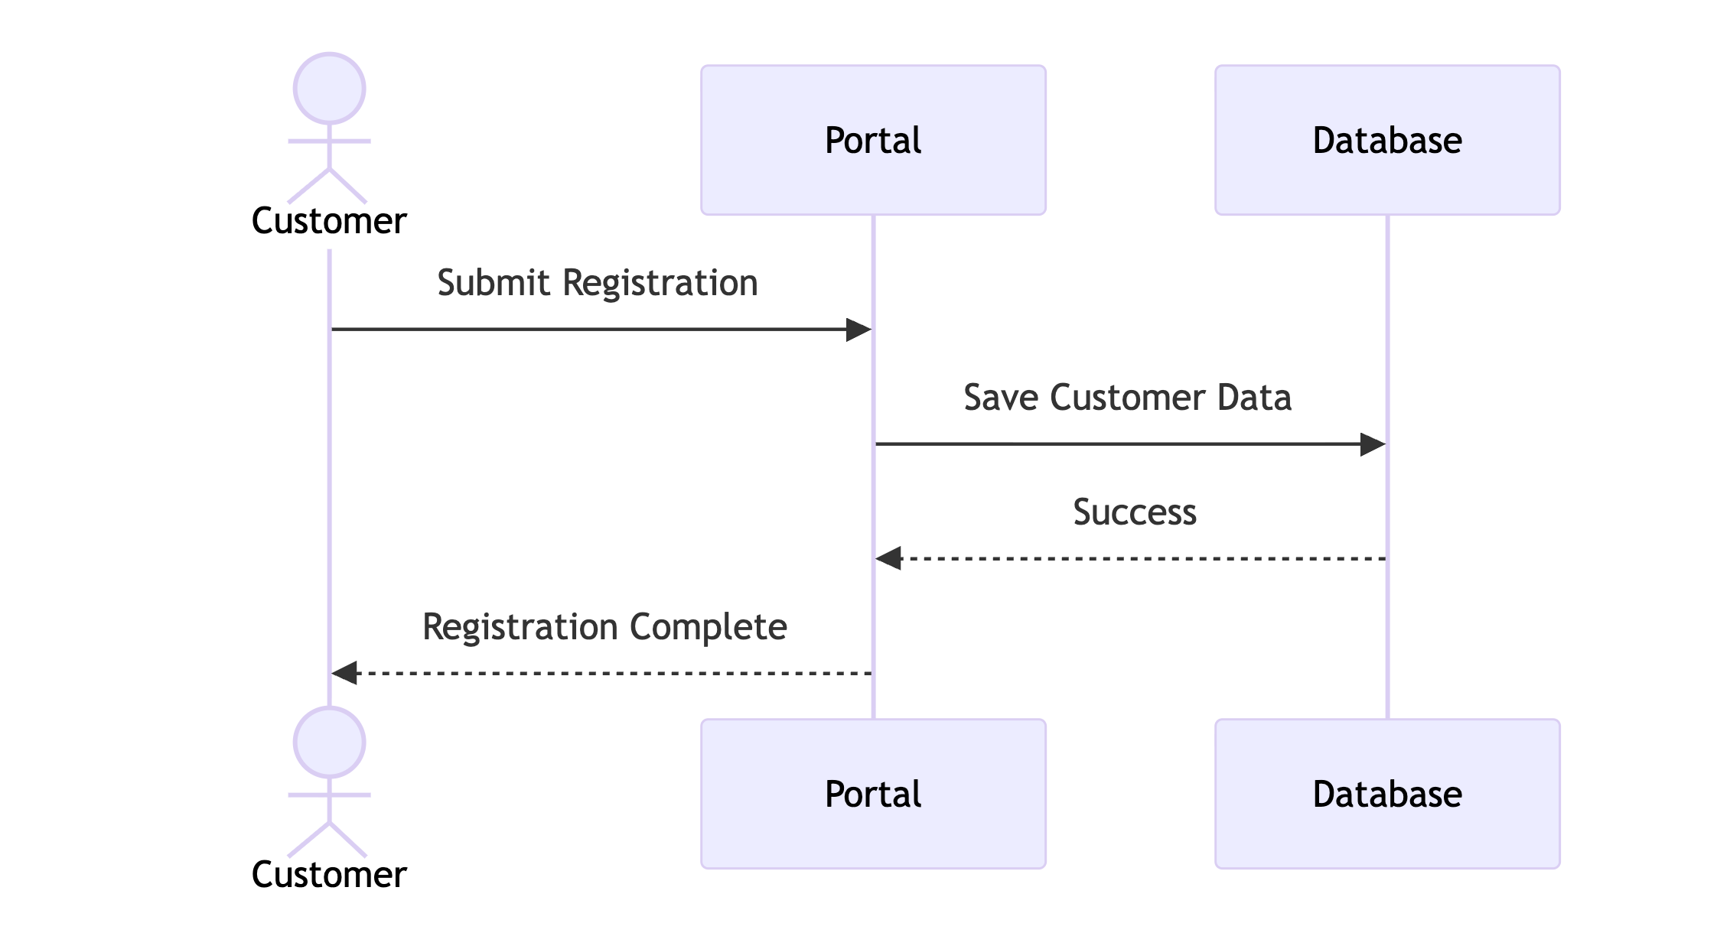
Customer – Member Registration

Slide 9
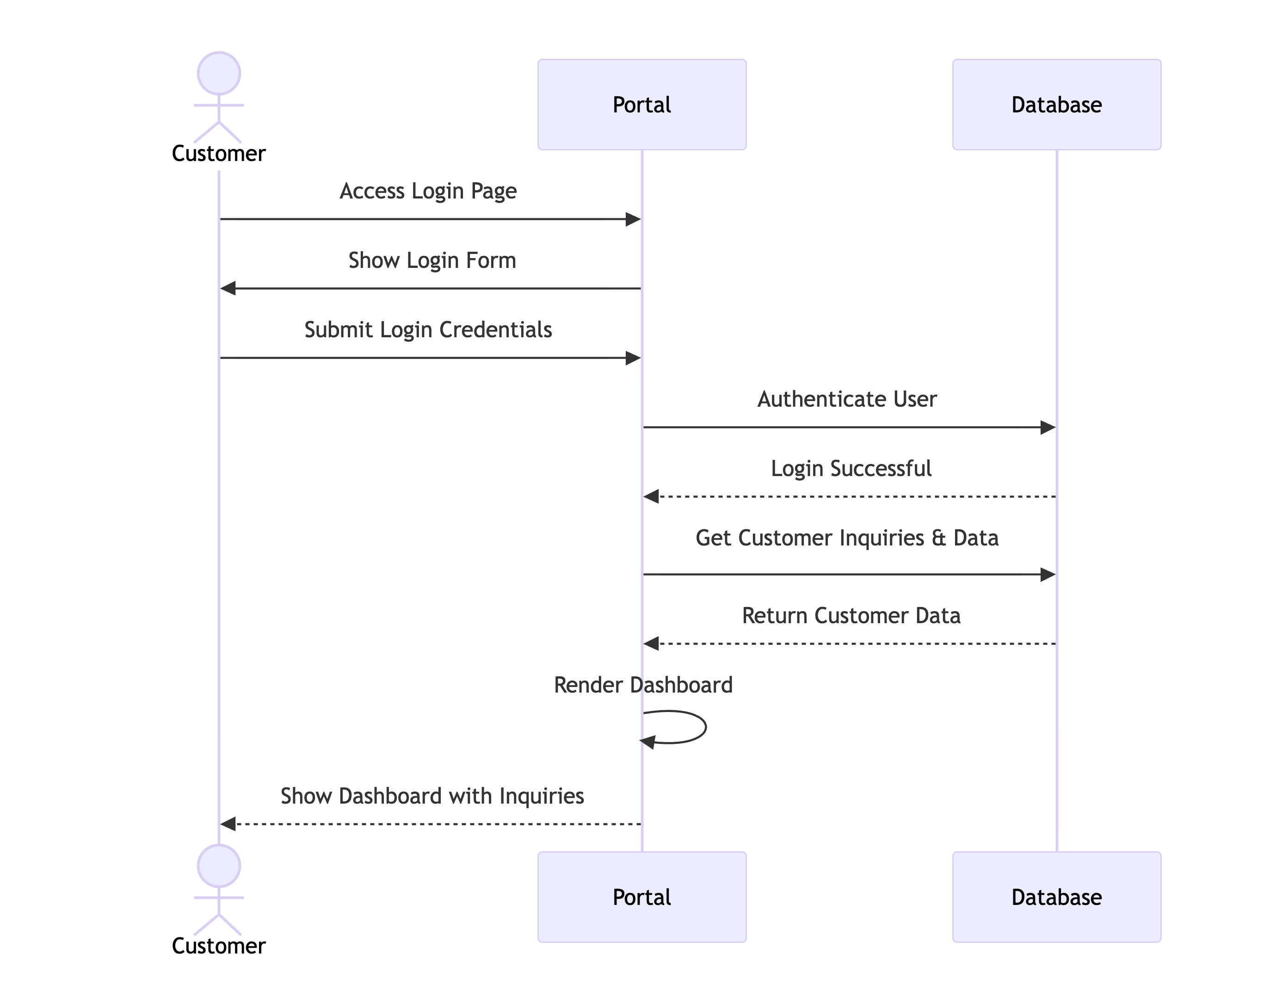
Customer – Login Dashboard

Slide 10
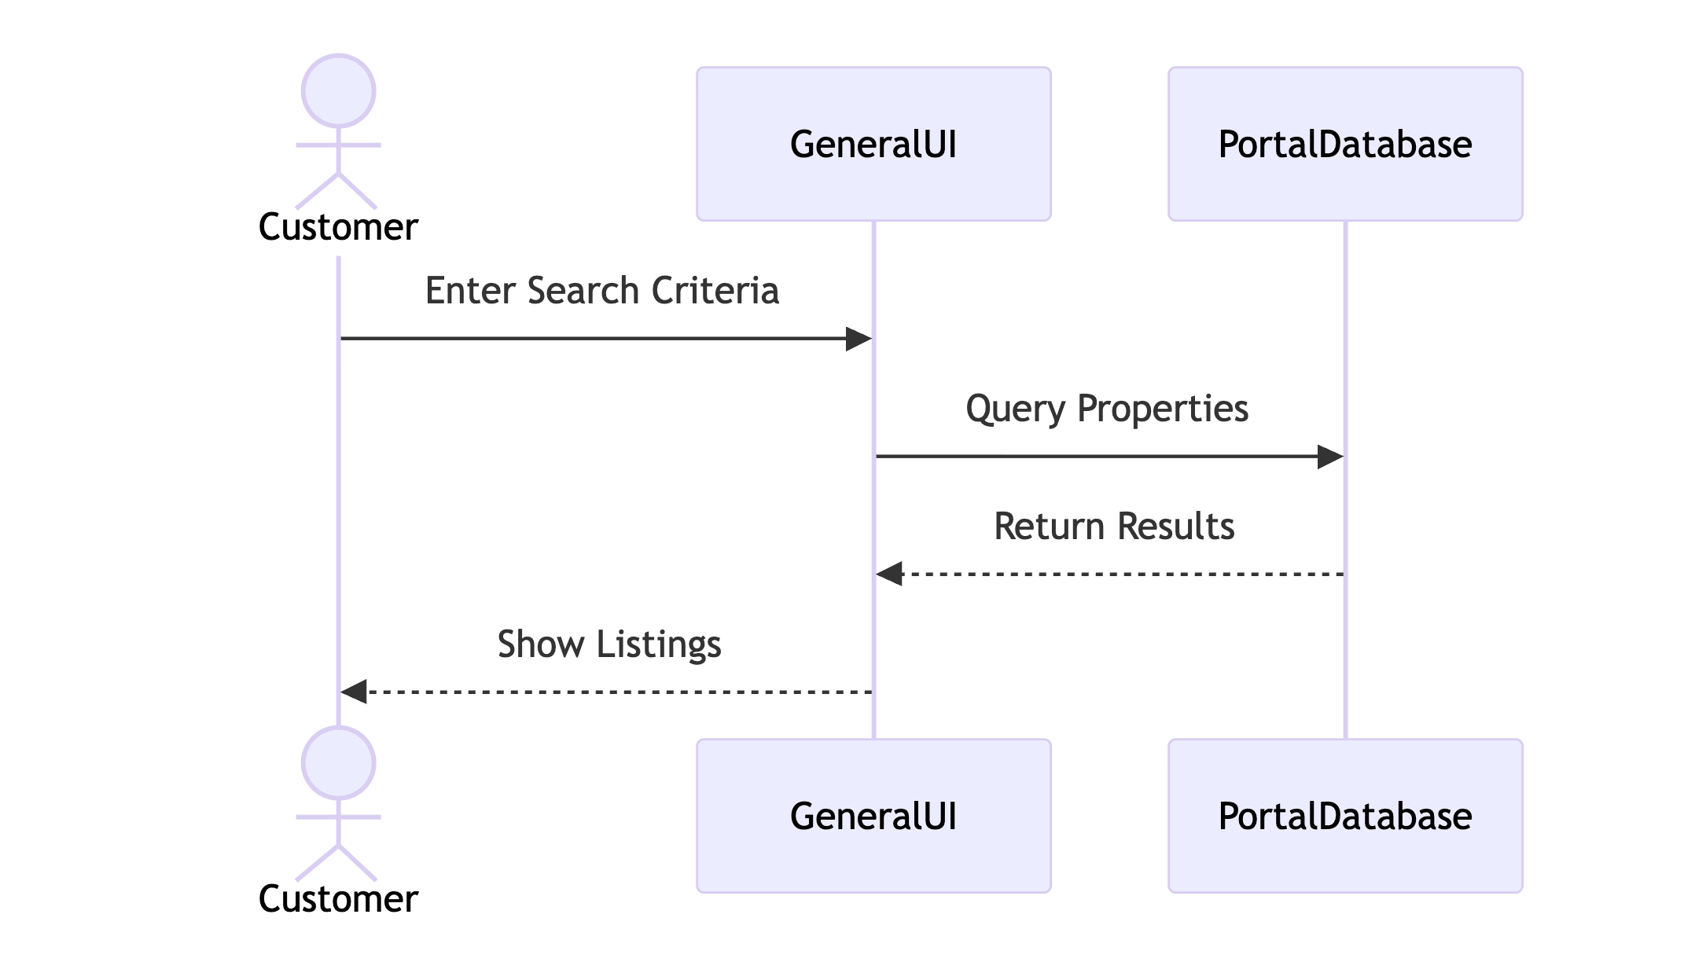
Customer – Search Property

Slide 11
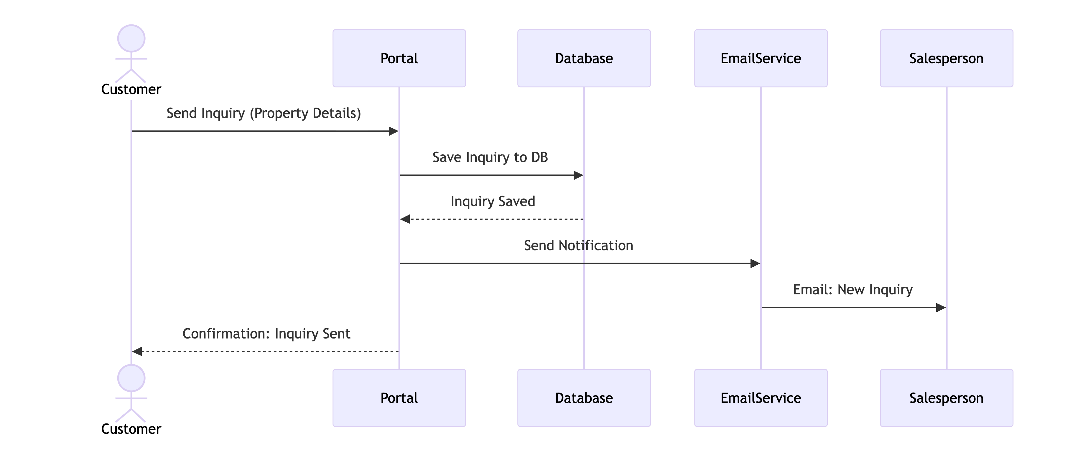
Customer - Property Inquiry

Slide 12
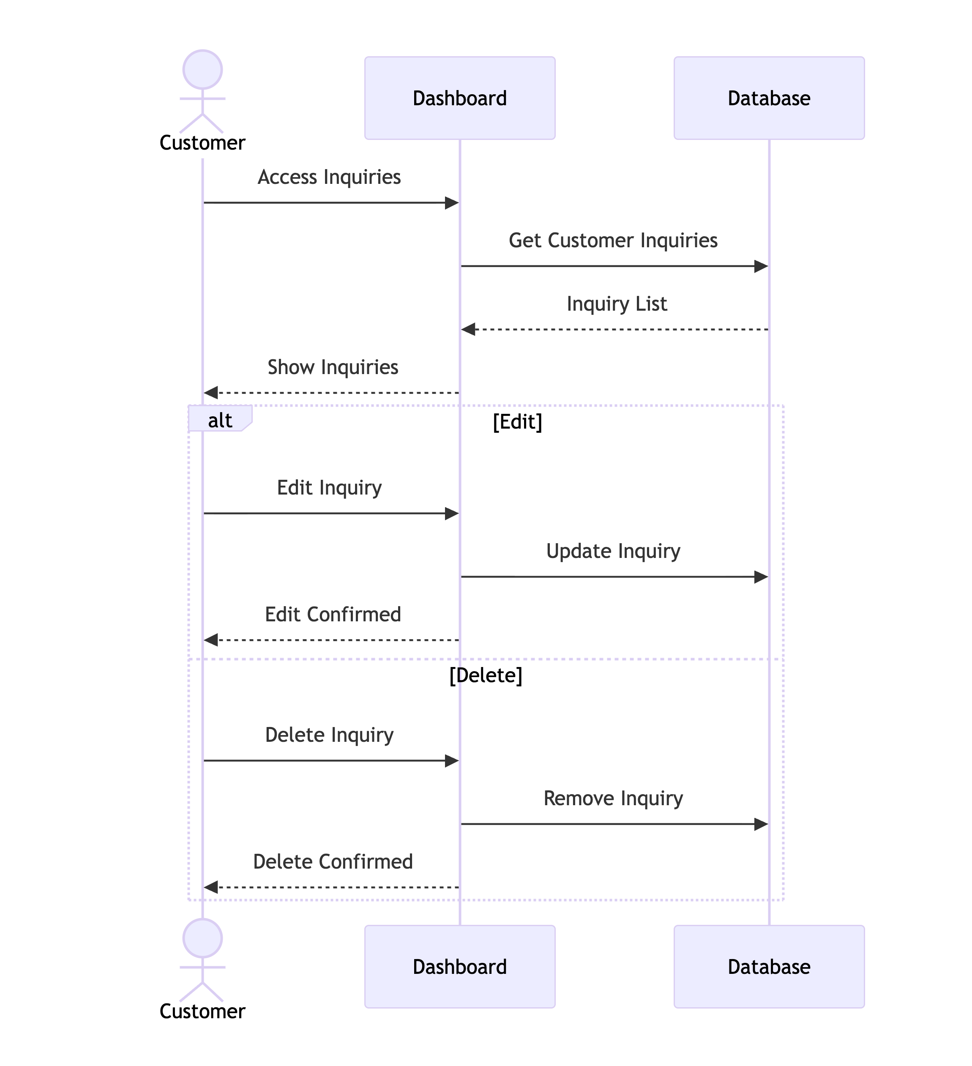
Customer - Edit / Delete Dashboard Inquiry

Slide 13
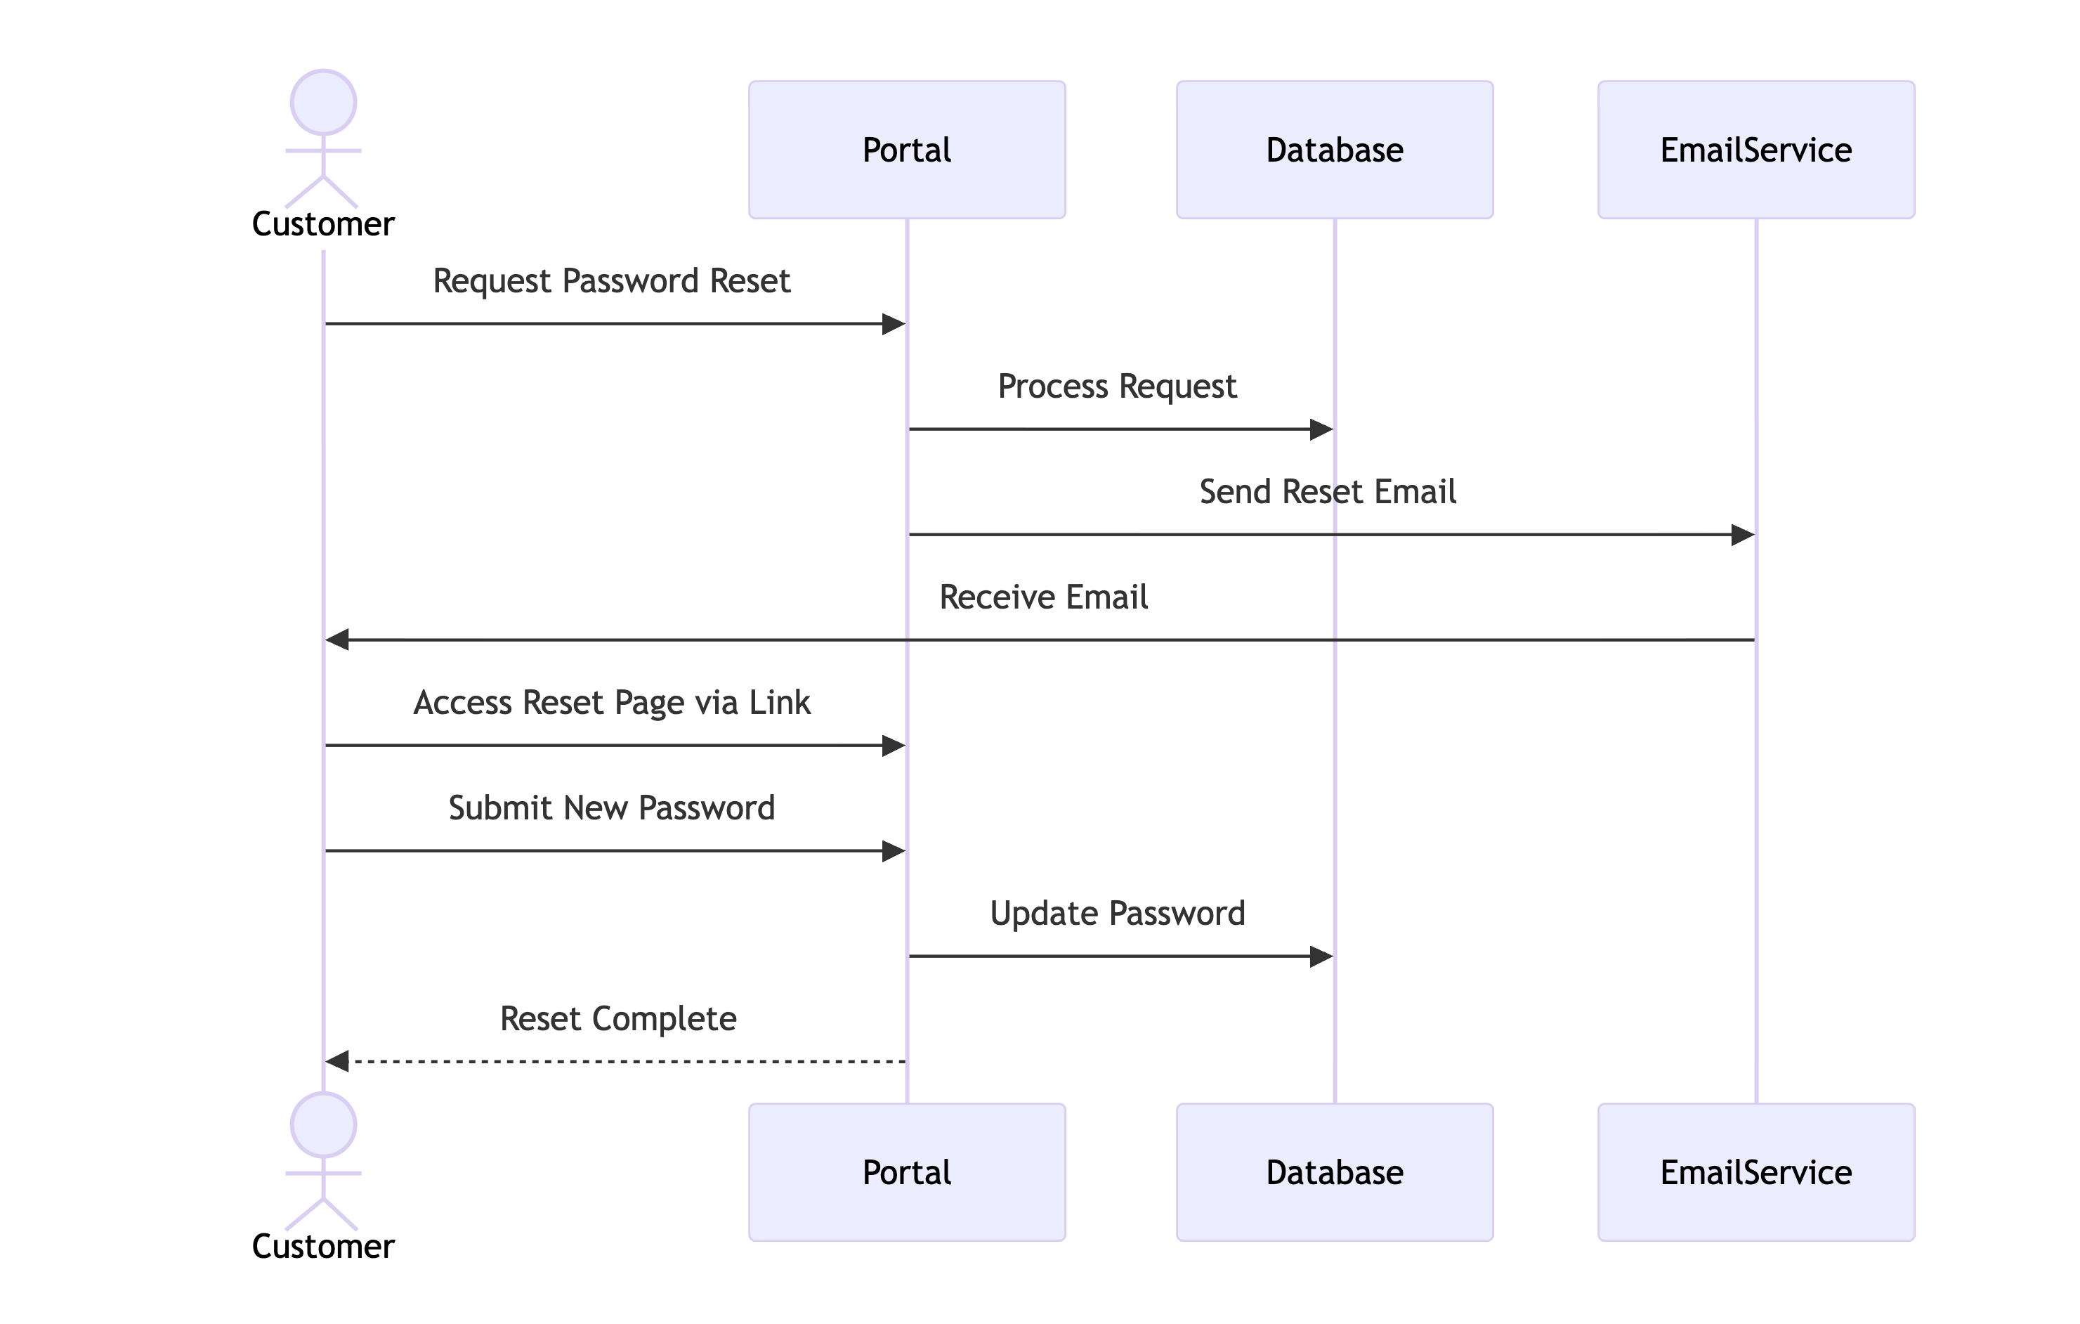
Customer - Reset Password

Slide 14
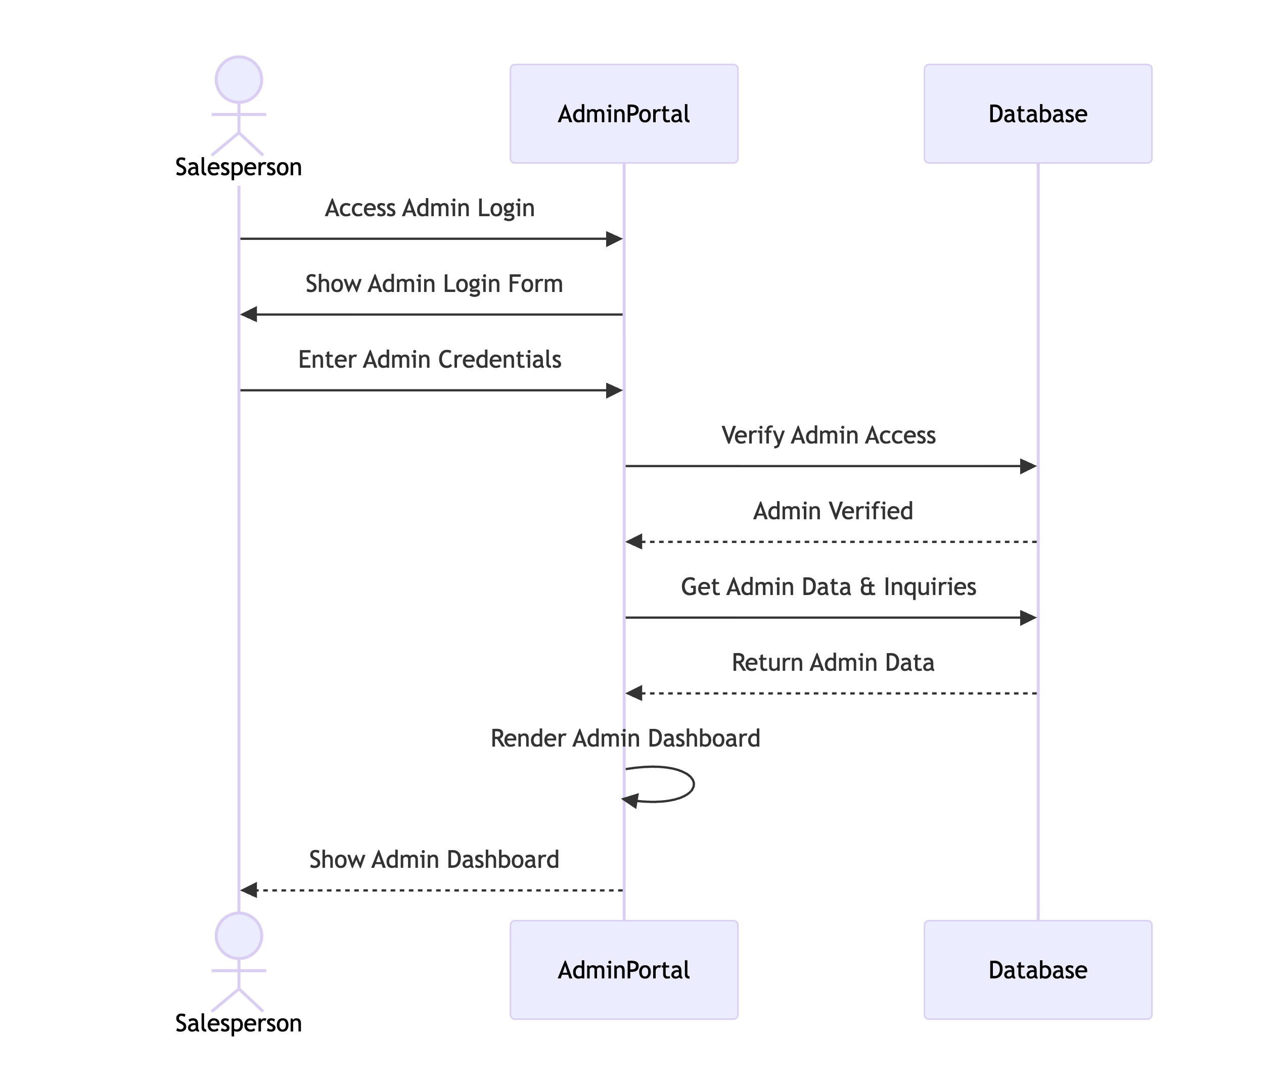
Salesperson - Login to Admin Dashboard

Slide 15
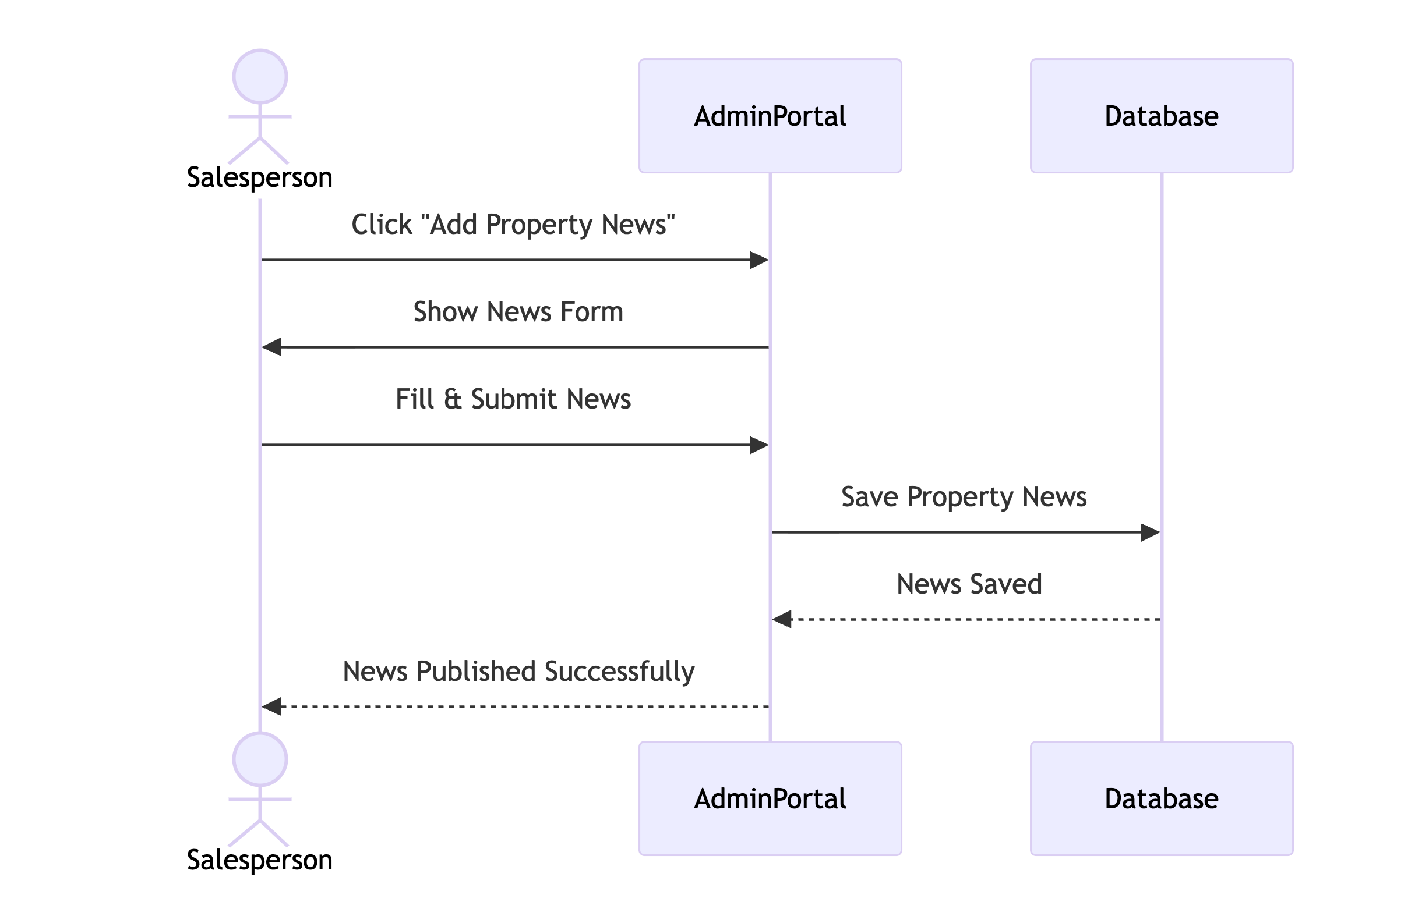
Salesperson - Add Property News

Slide 16
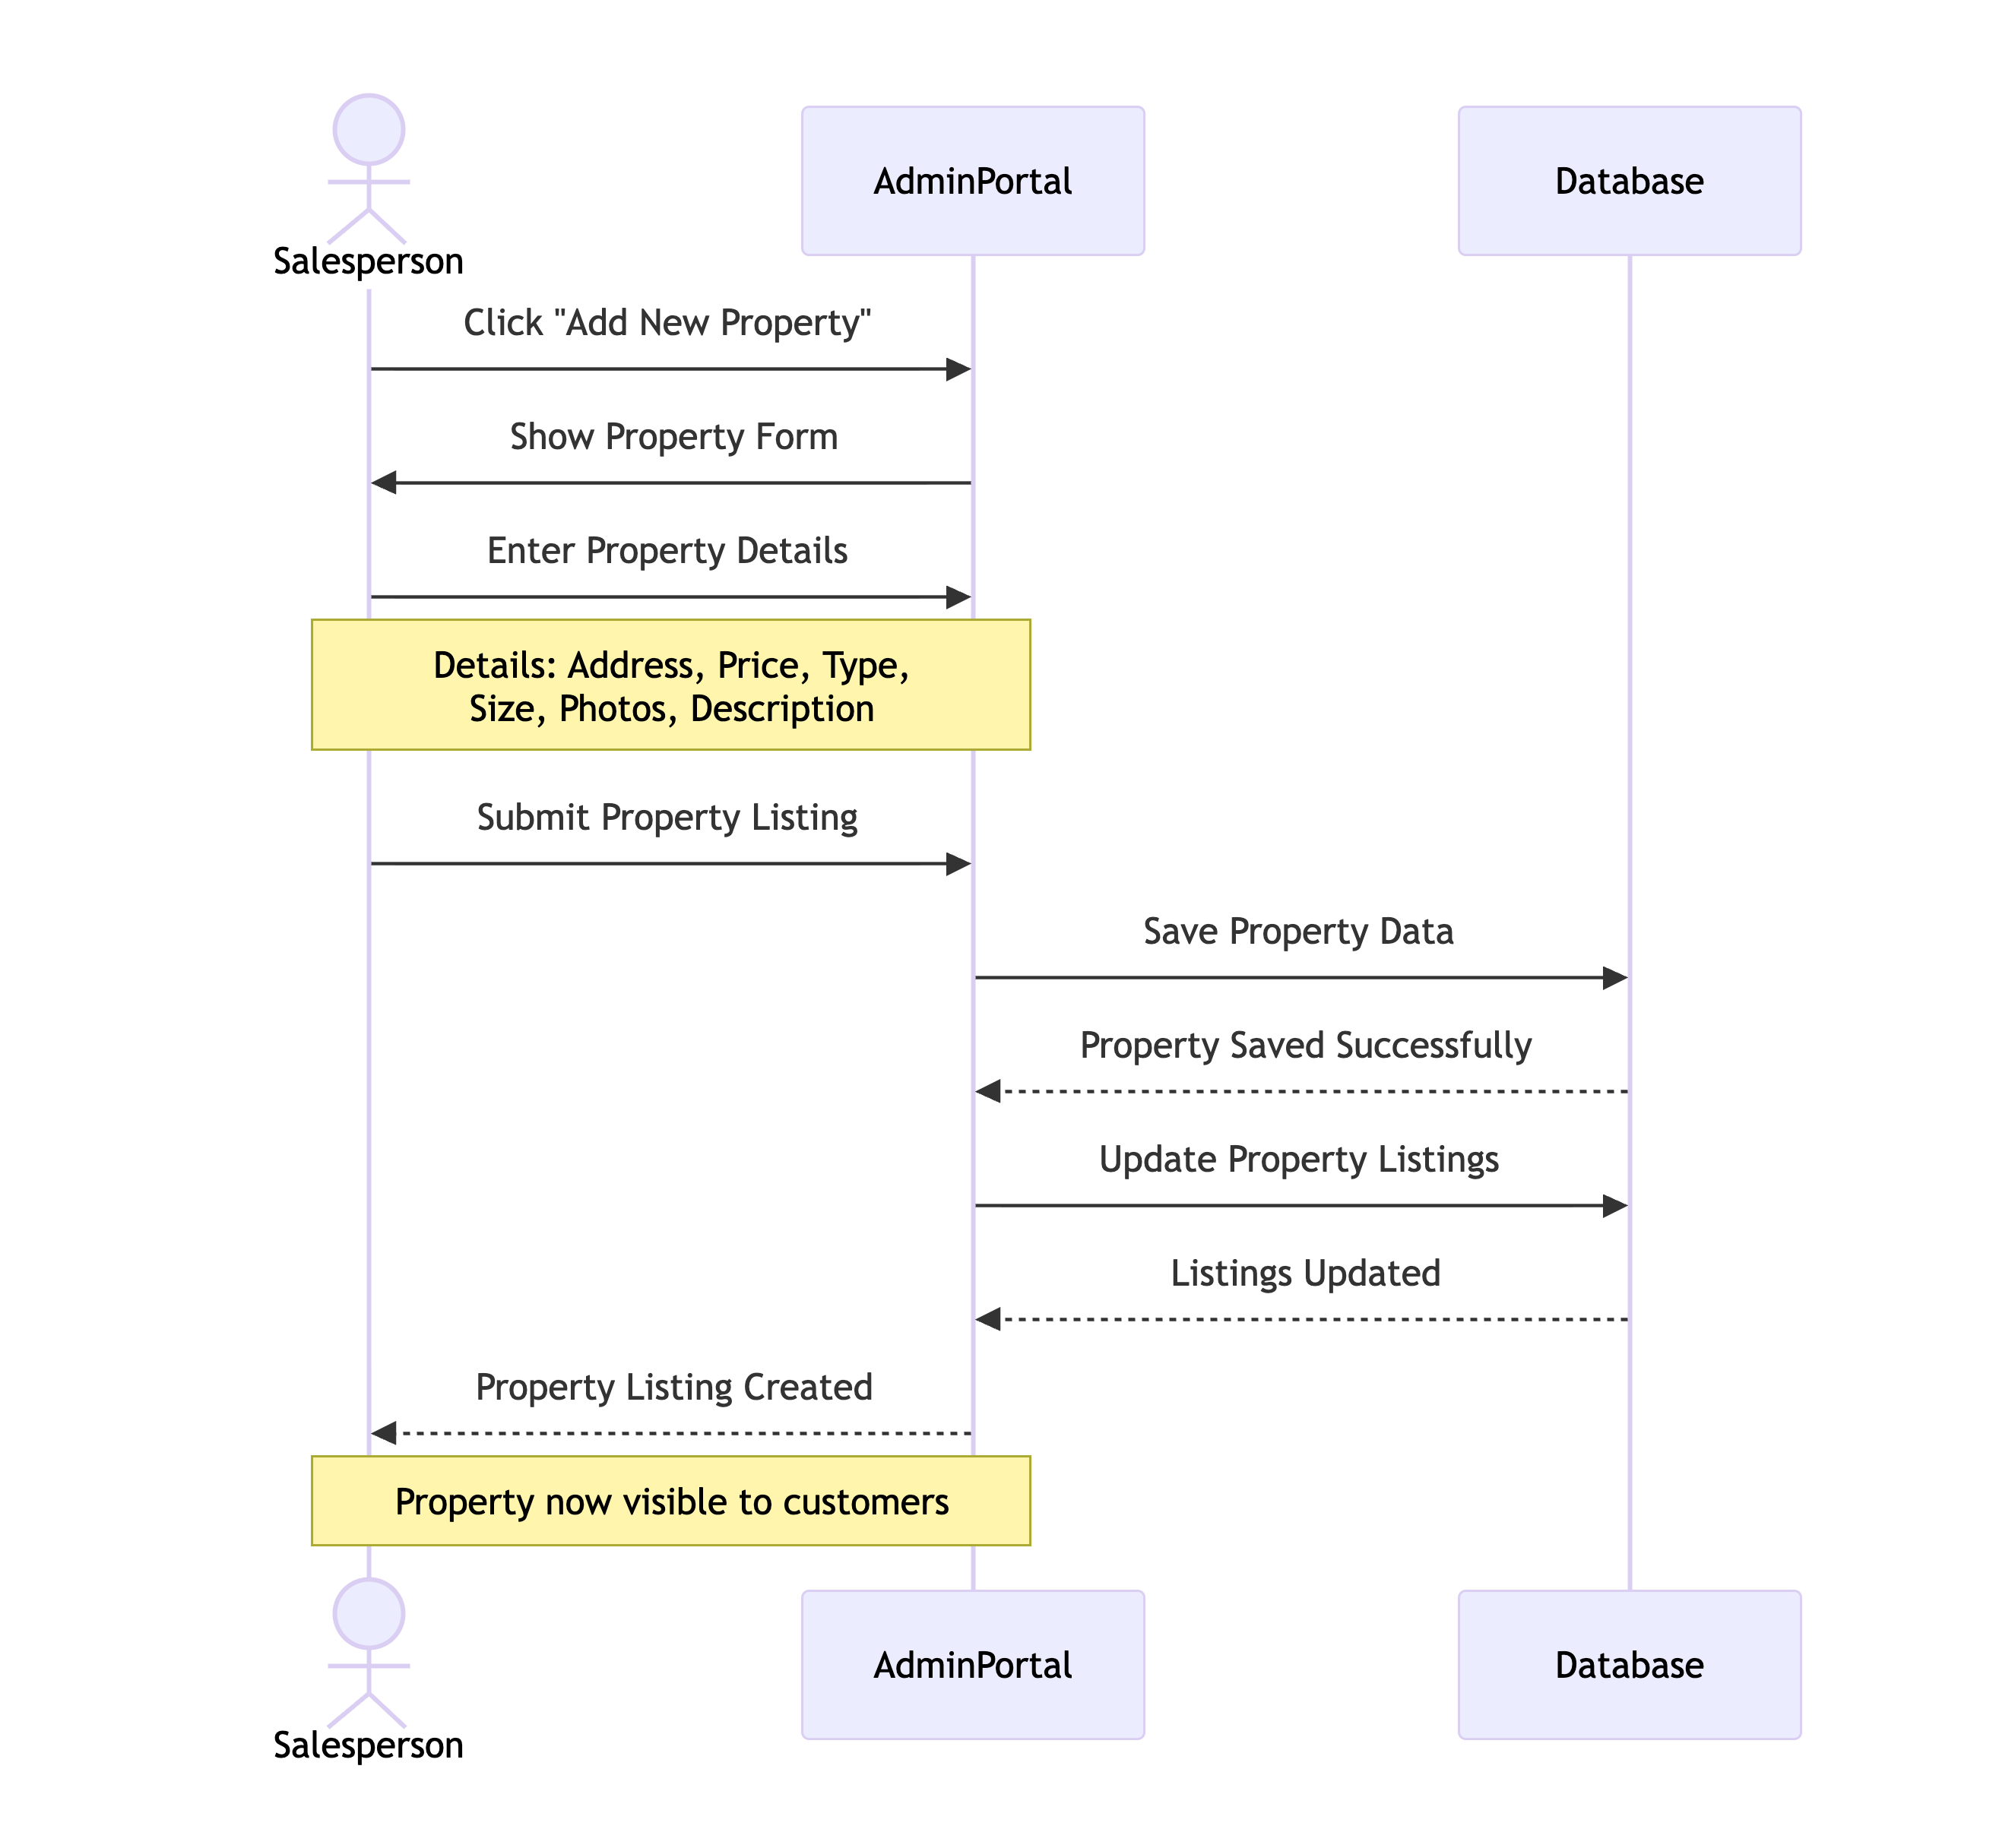
Salesperson - Add Property List

Slide 17
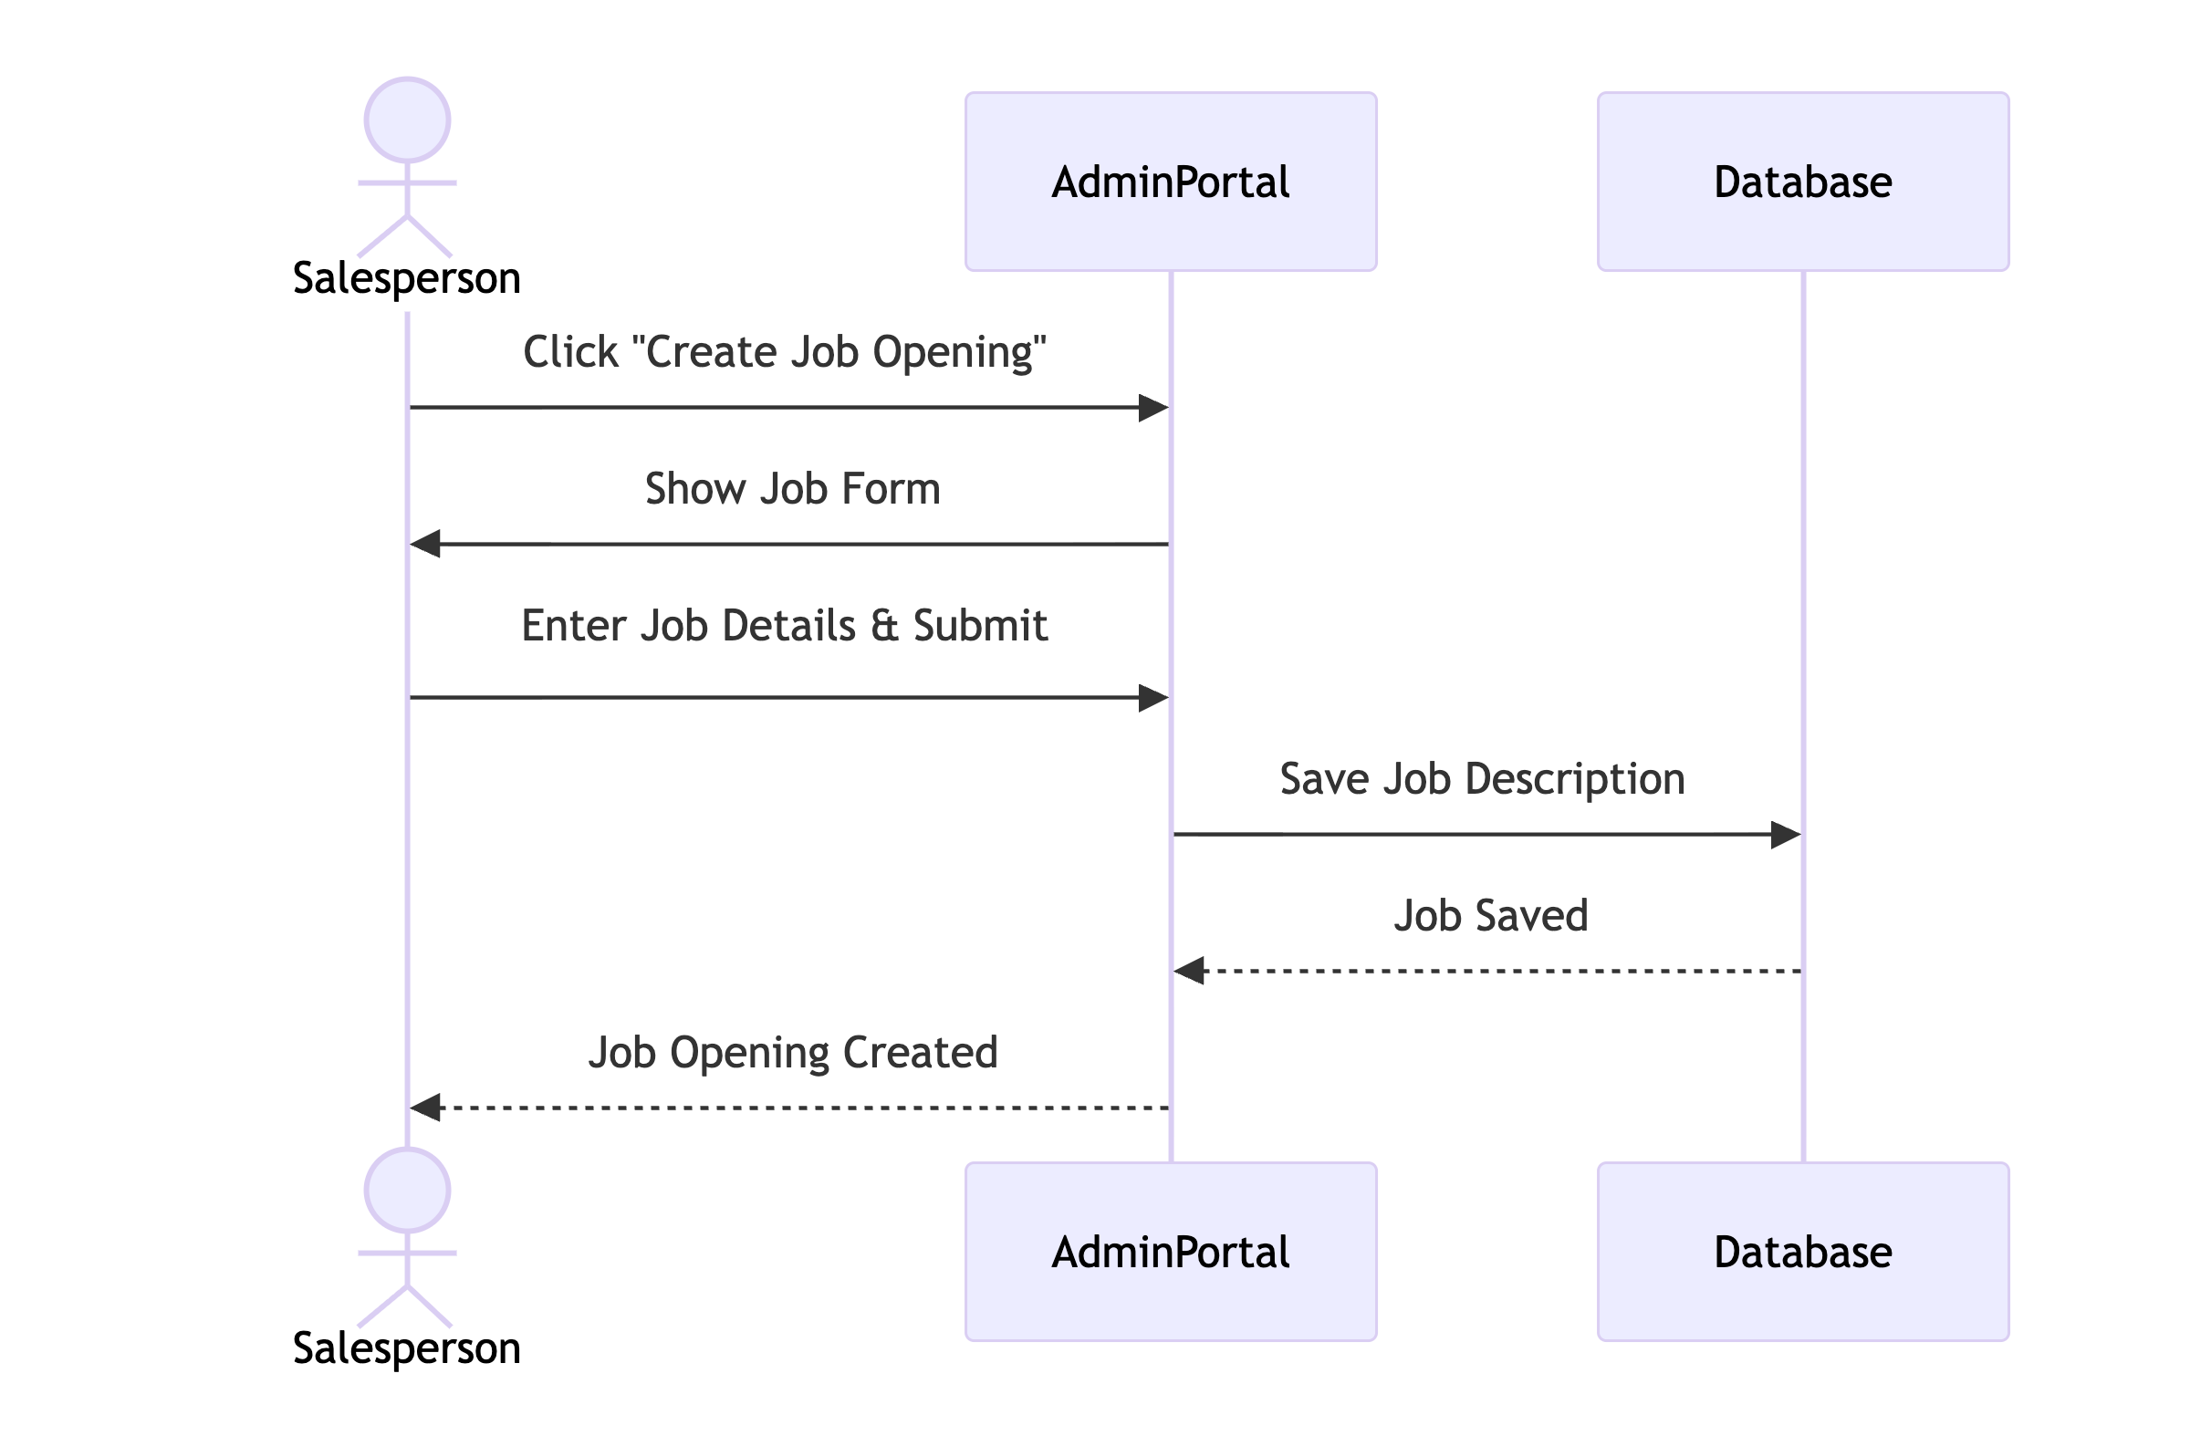
Salesperson - Create Job Opening

Slide 18
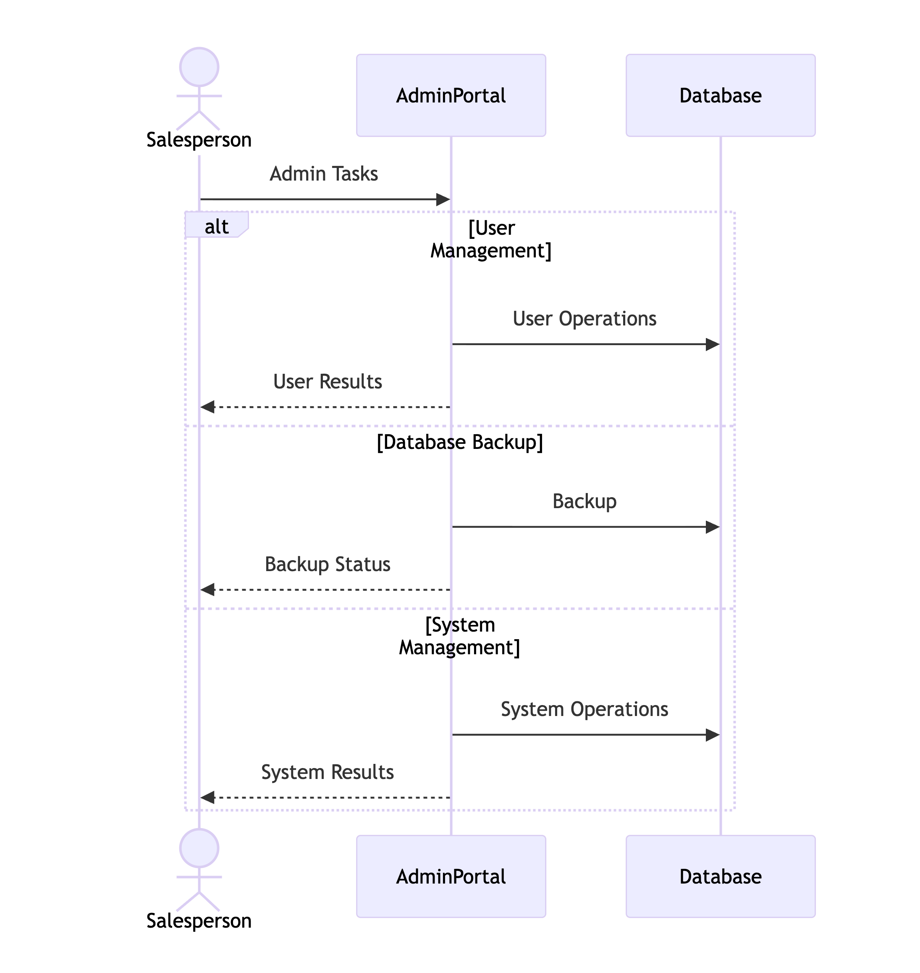
Salesperson - Admin Task

Slide 19
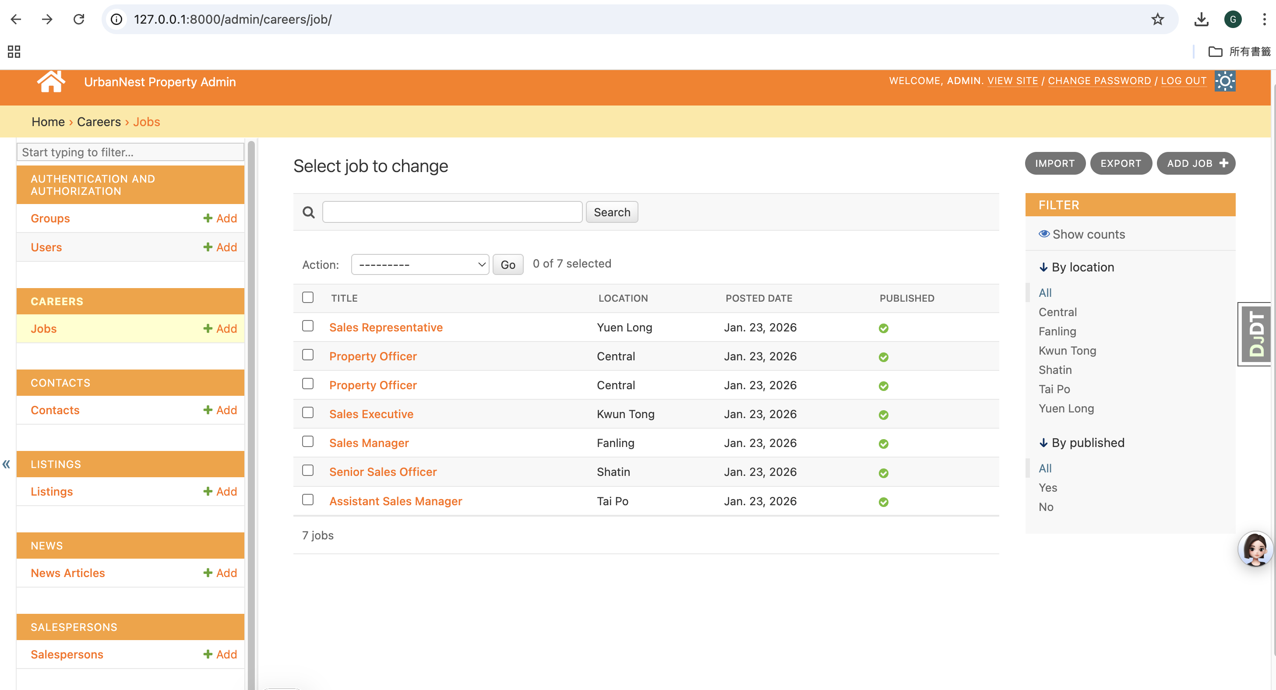
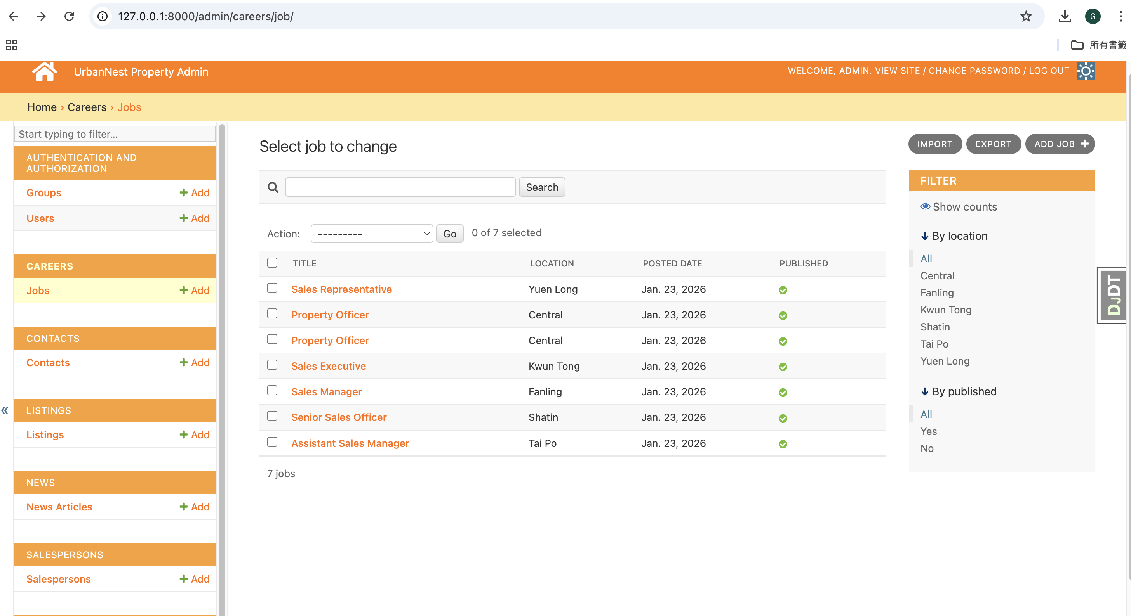
Admin Portal 1 (Records Management)

Slide 20
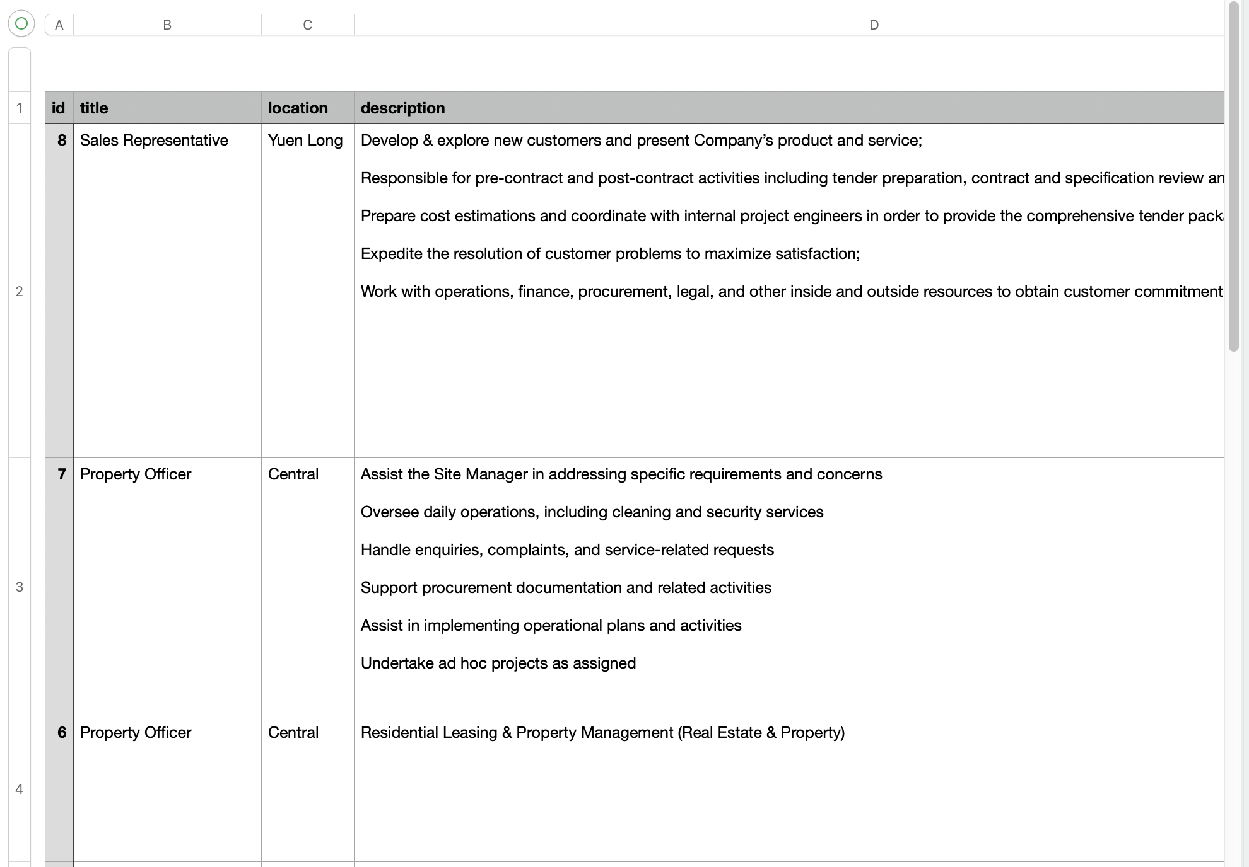
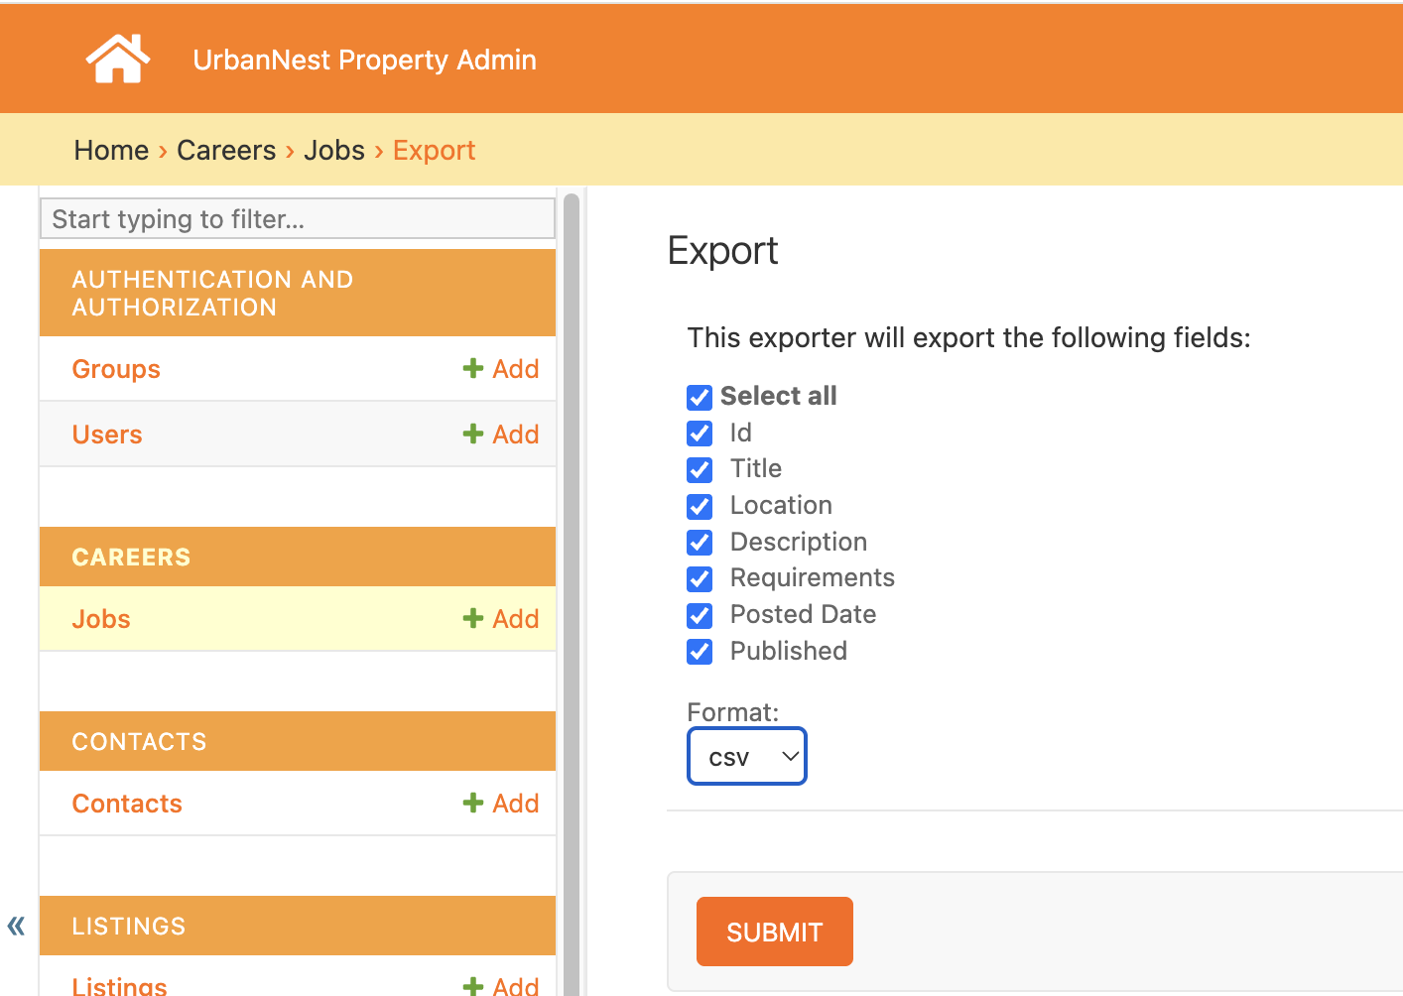
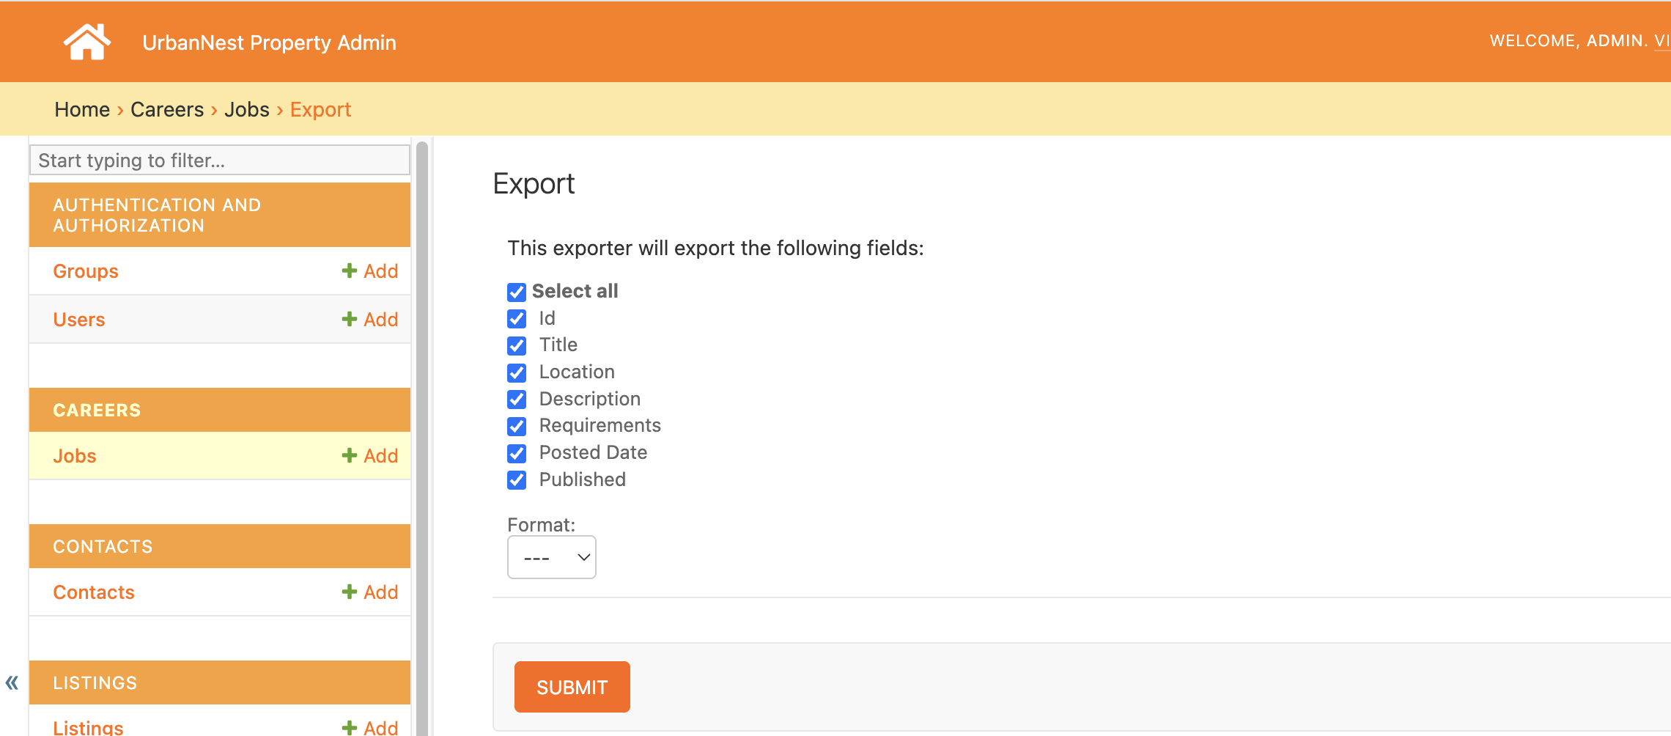
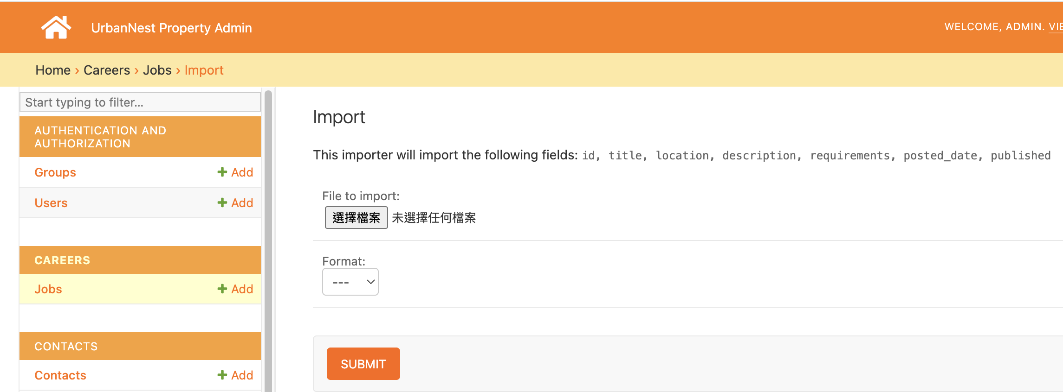
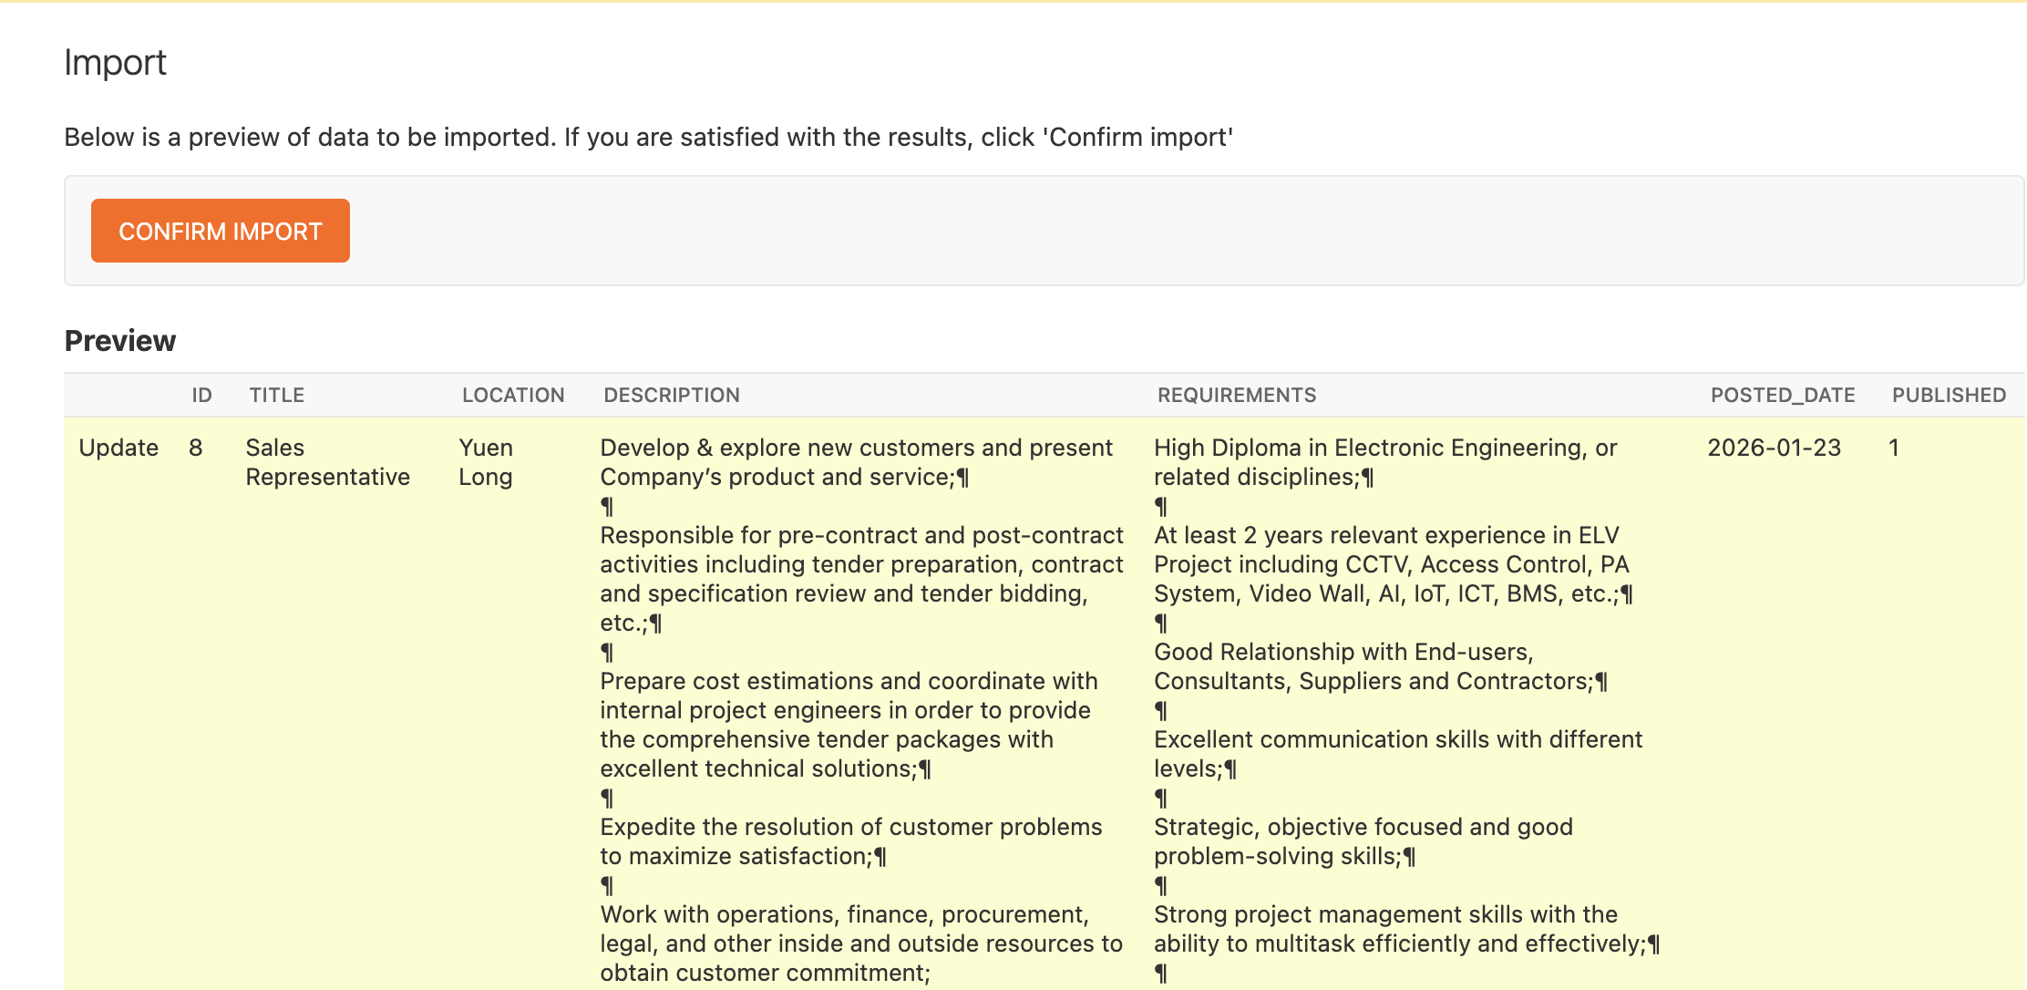
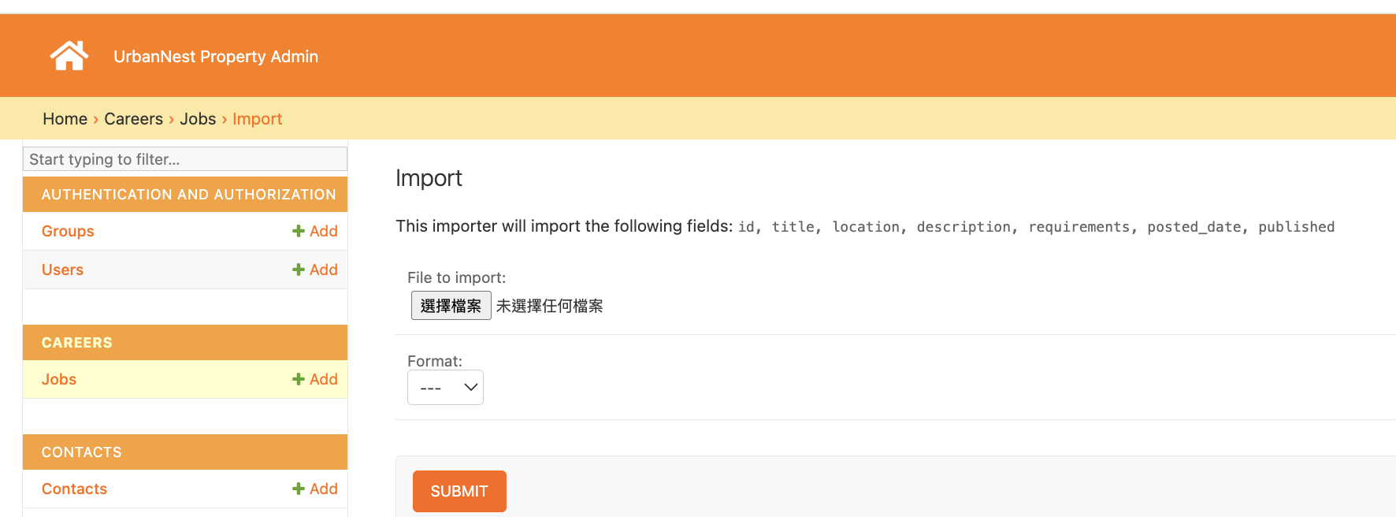
Admin Portal 2 (DB Export / Import)

Slide 21
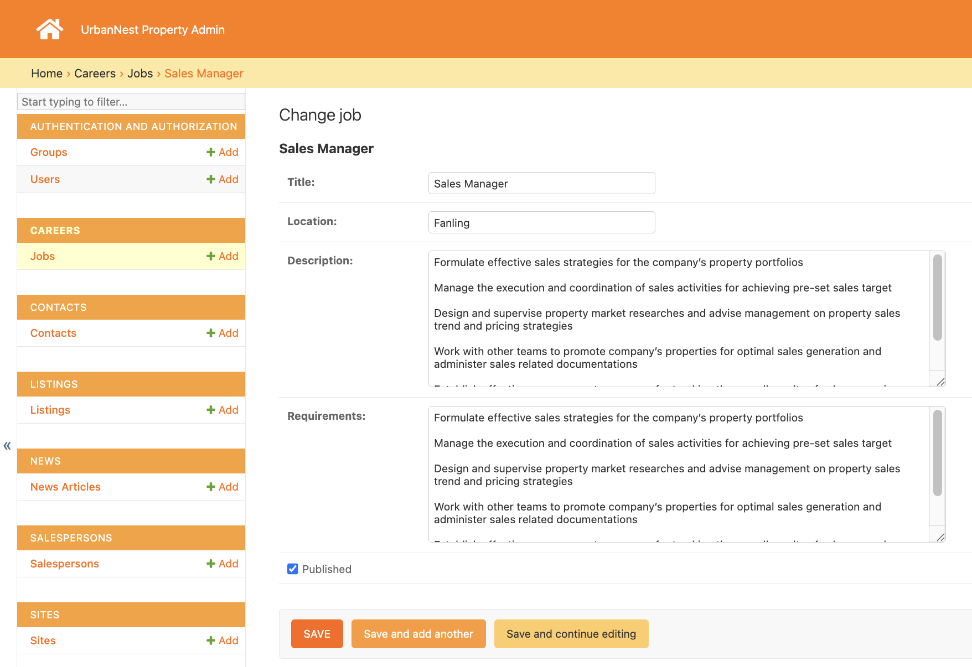
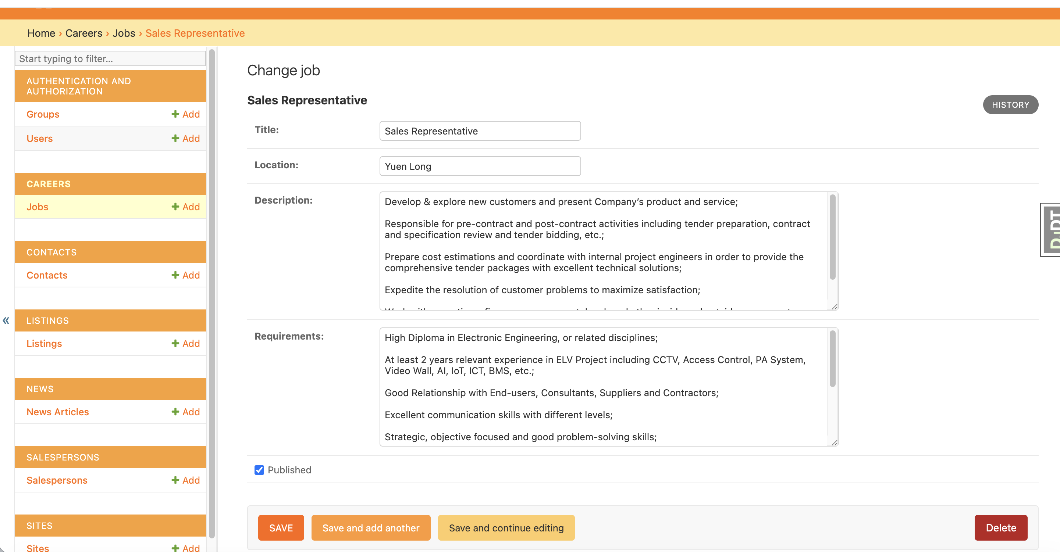
Admin Portal 3 (Edit record)

Slide 22
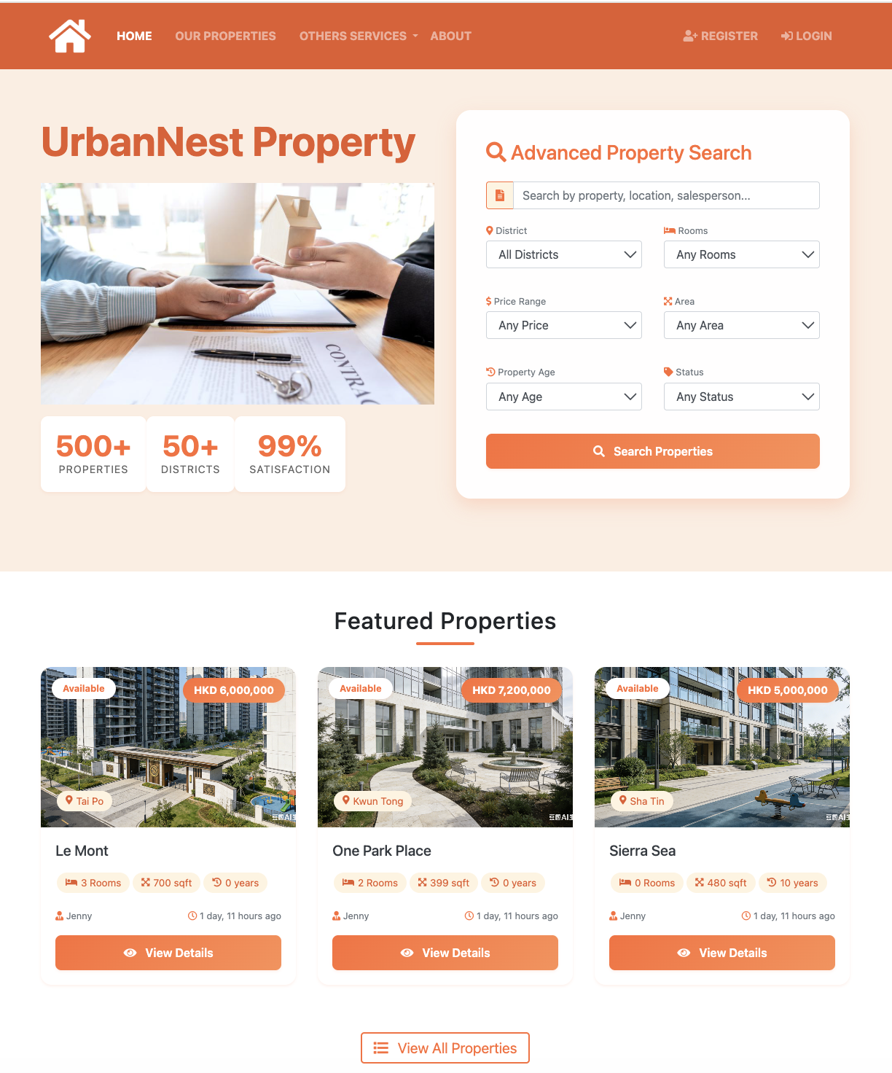
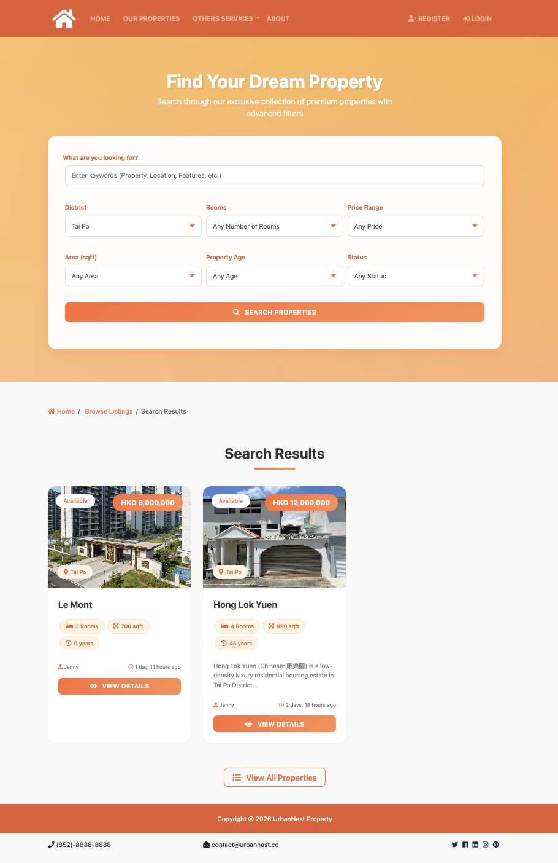
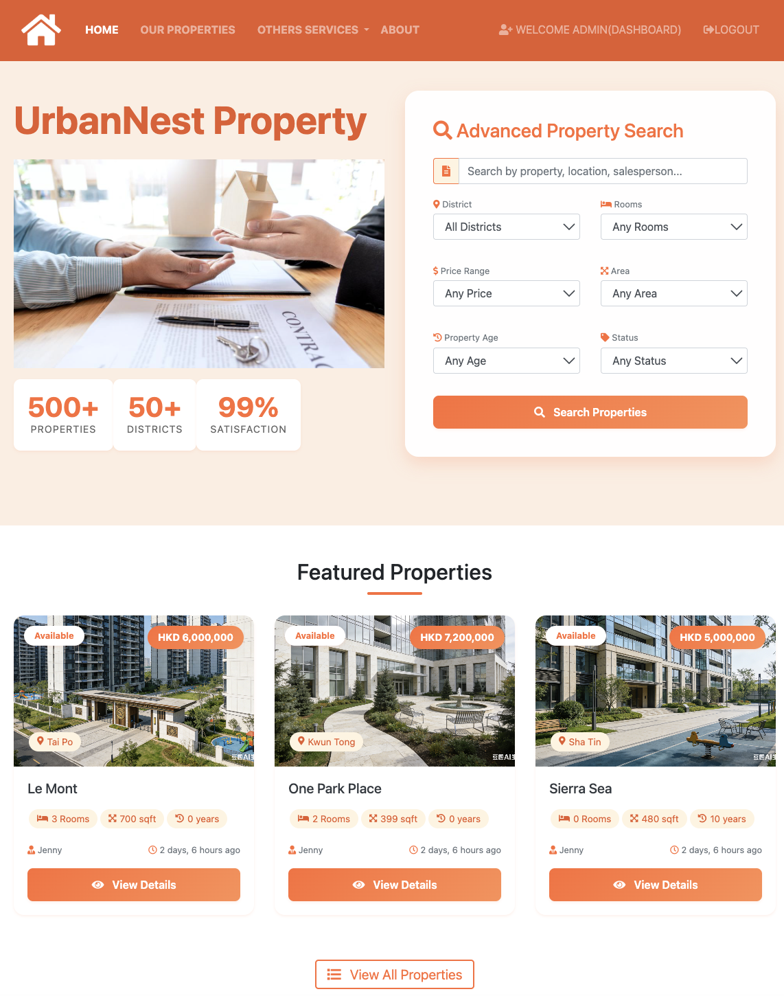
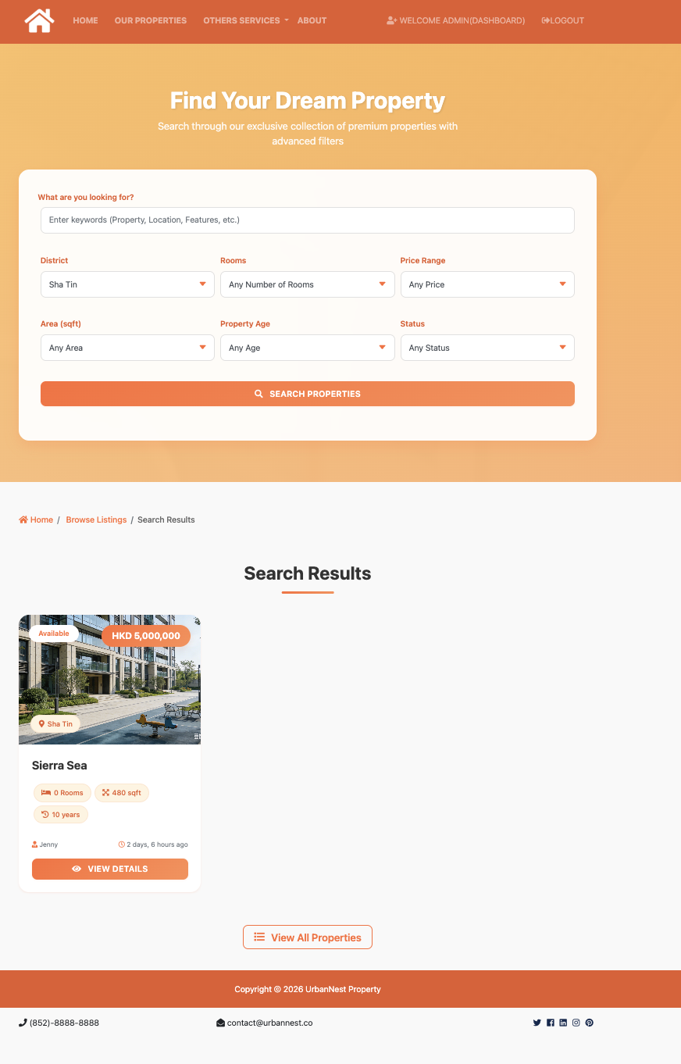
Homepage & Search page

Slide 23
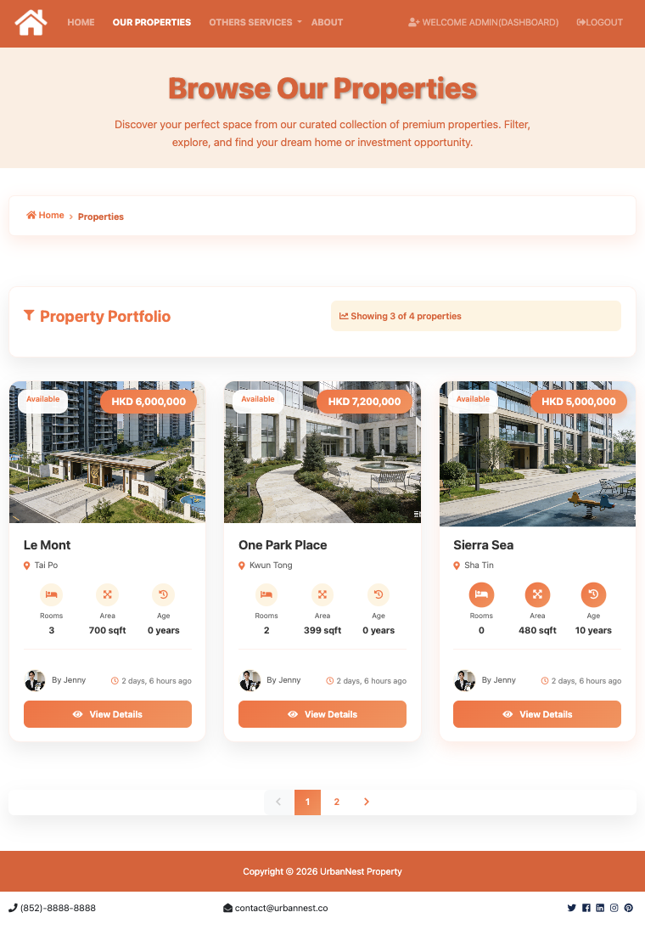
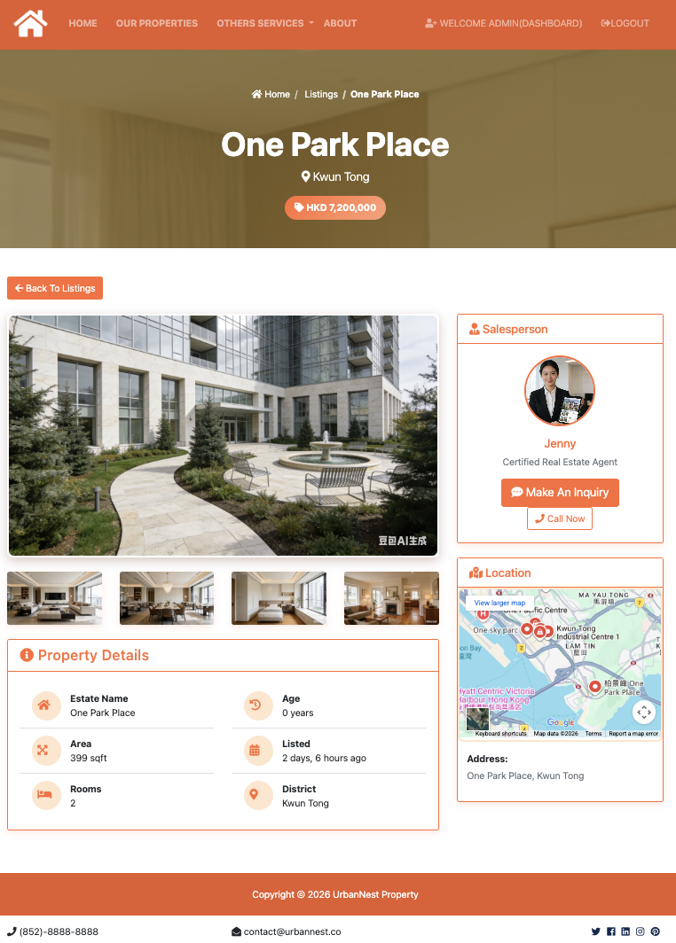
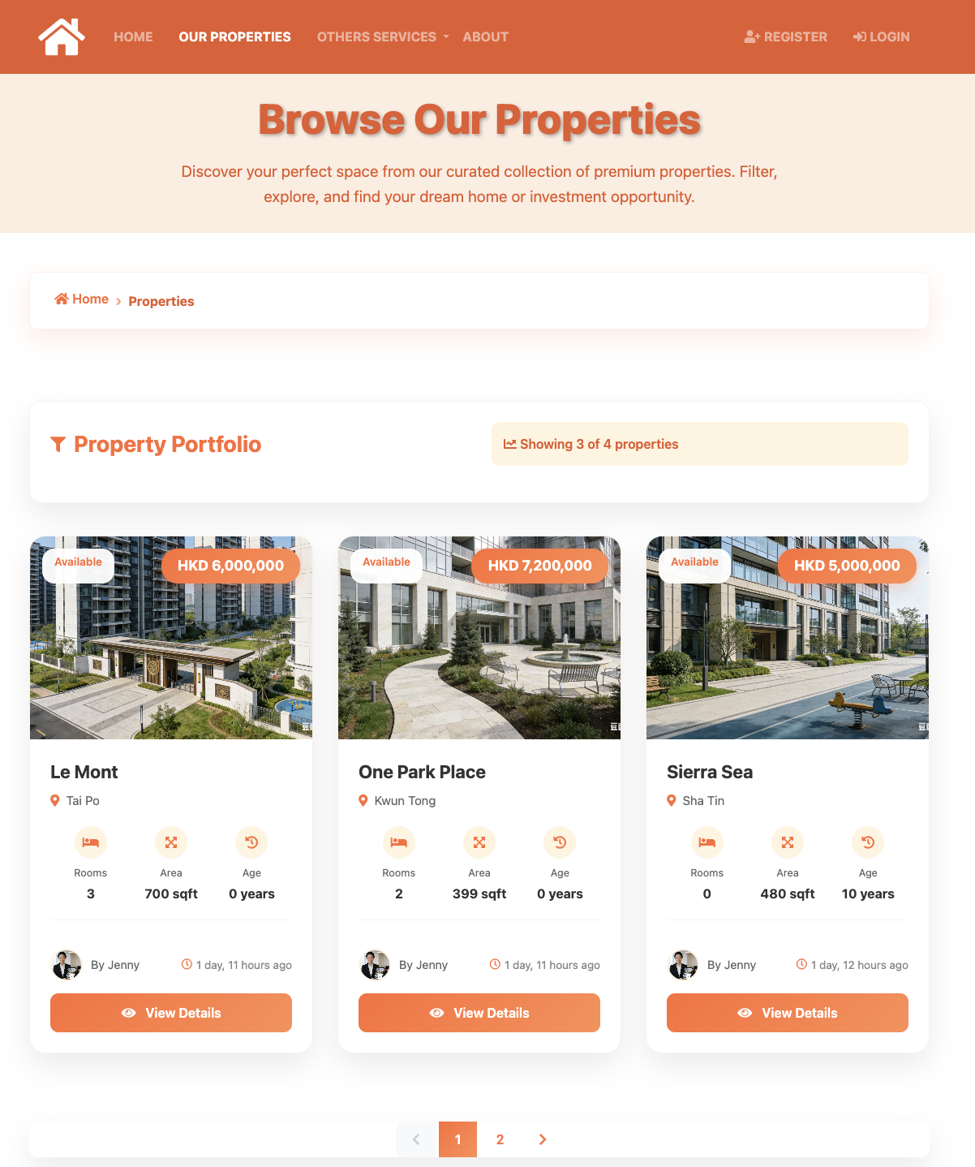
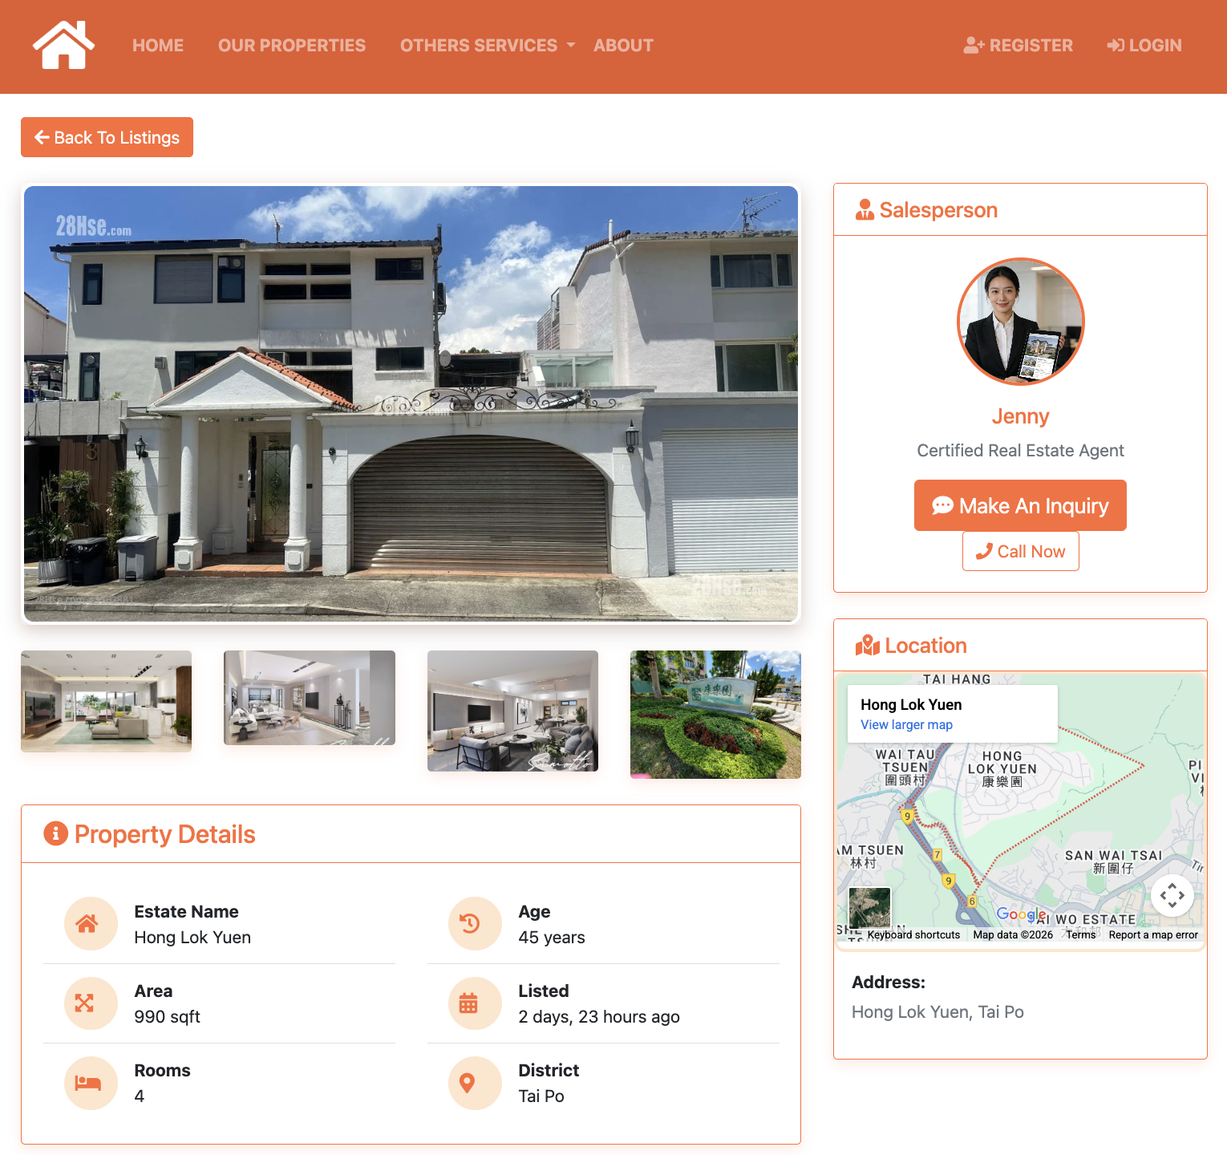
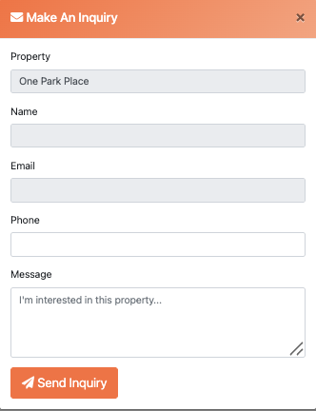
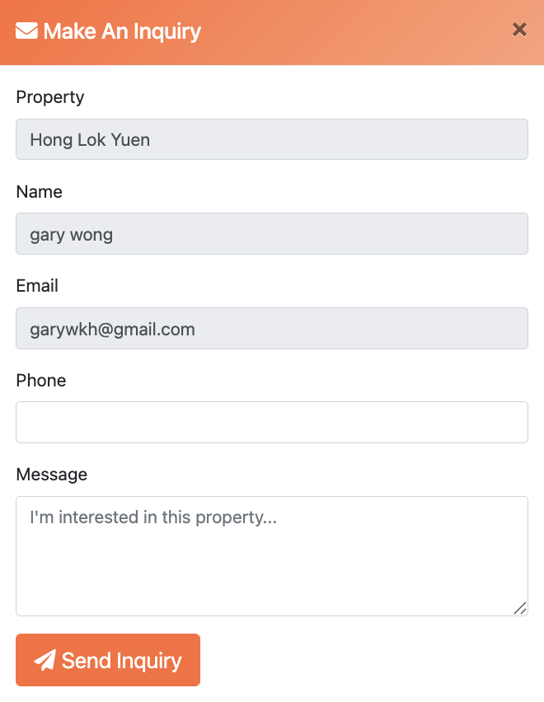
Our properties & Property details & Inquiry

Slide 24
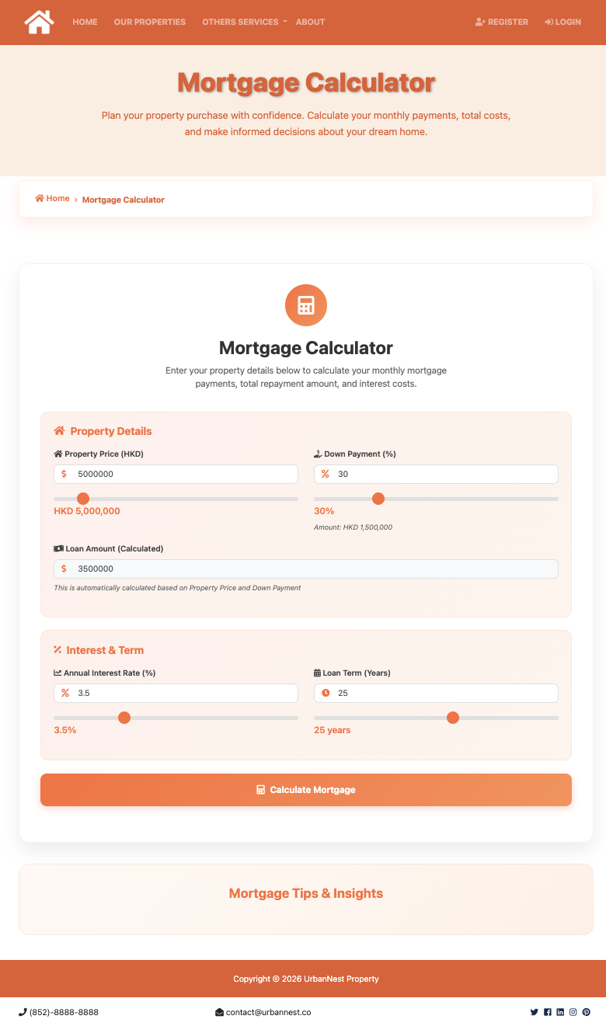
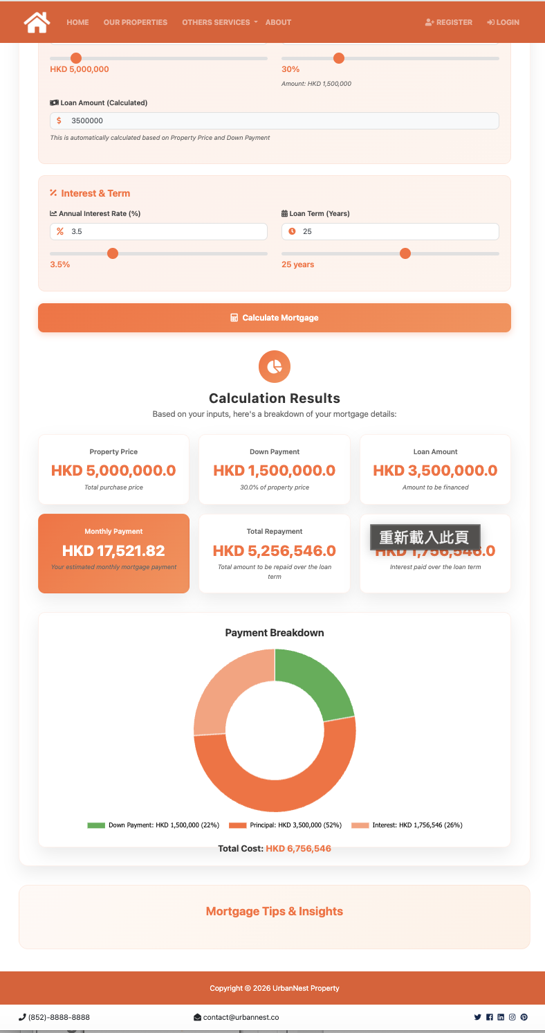
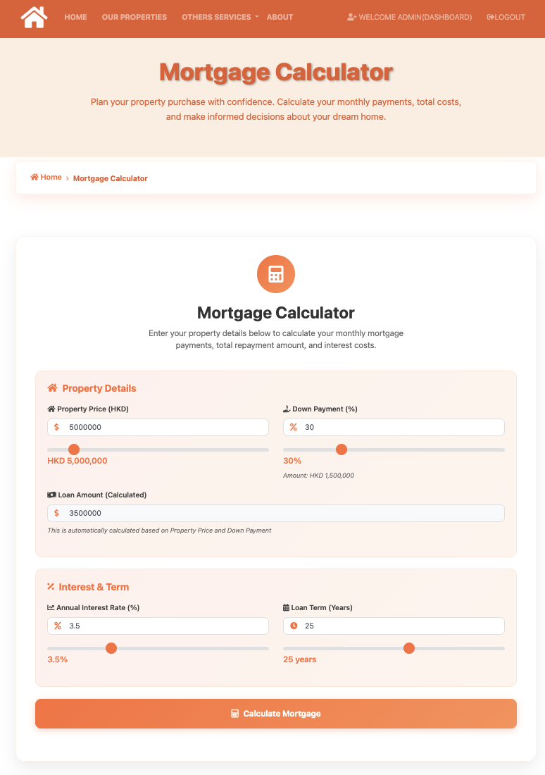
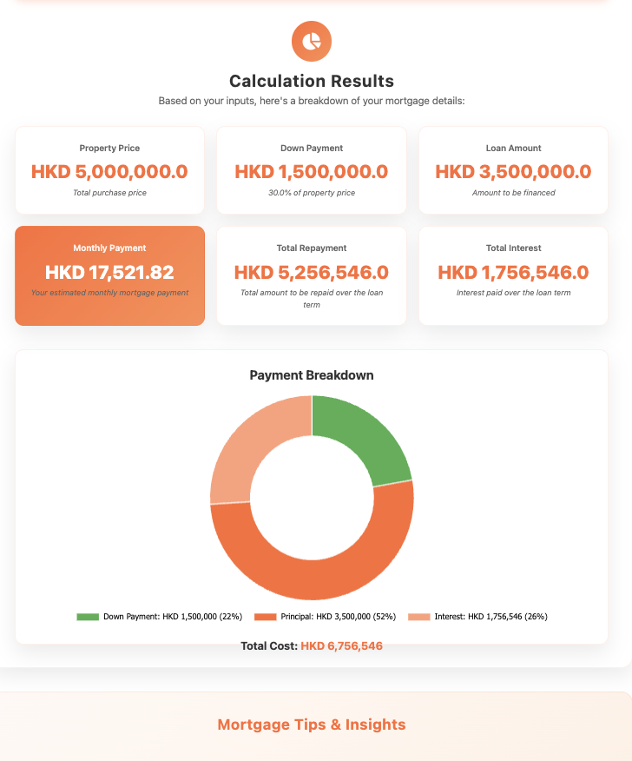
Other Services – Mortgage Calculator

Slide 25
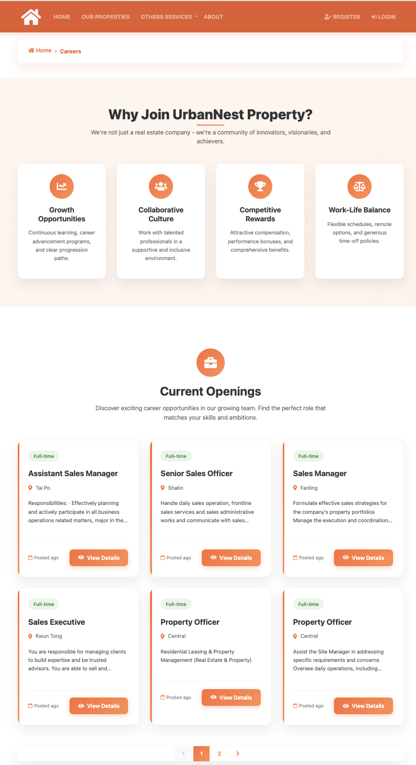
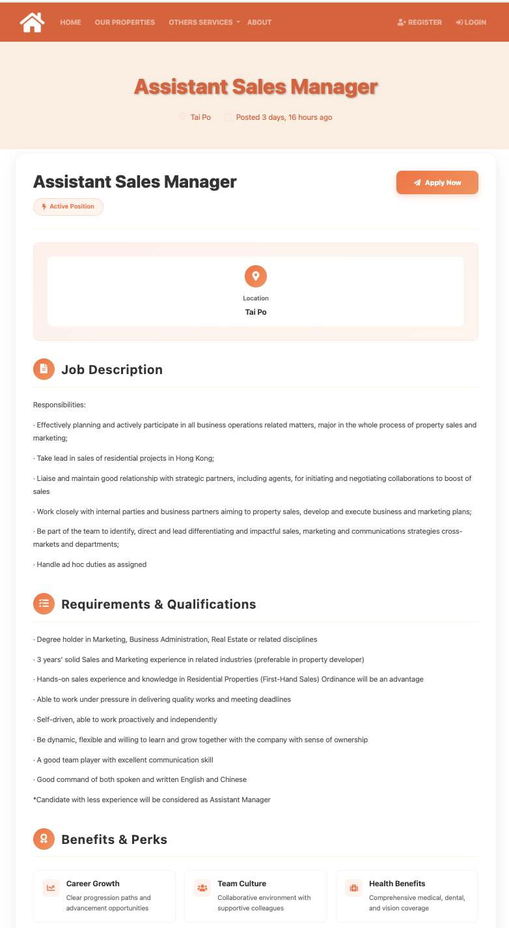
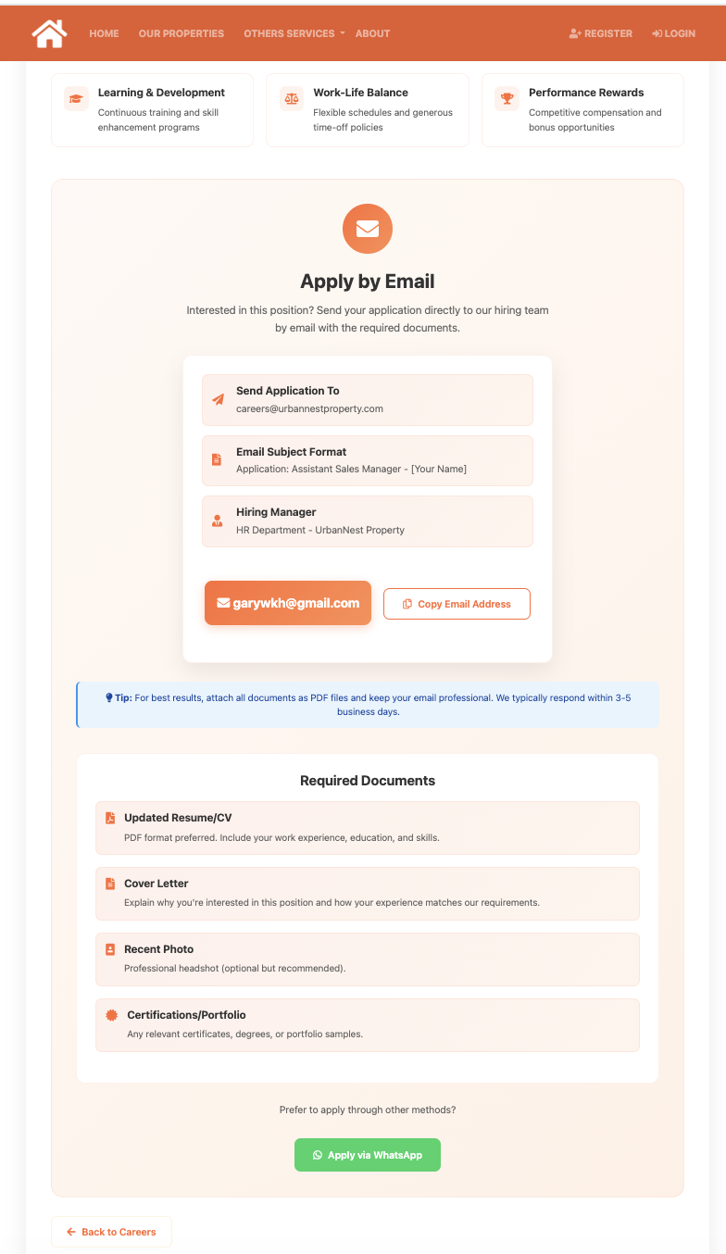
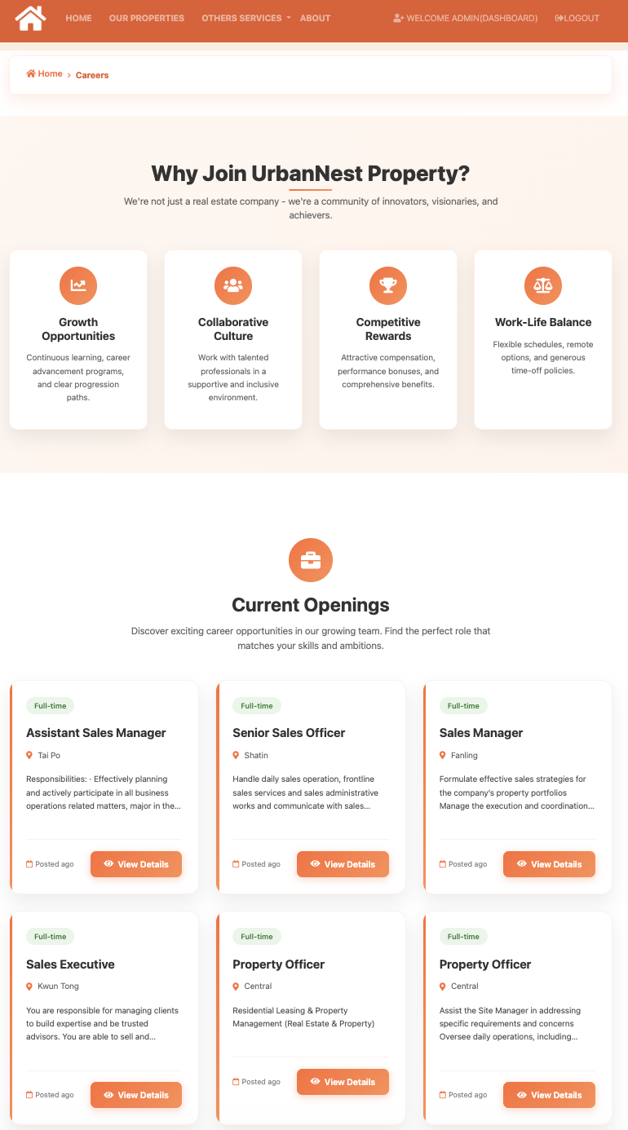
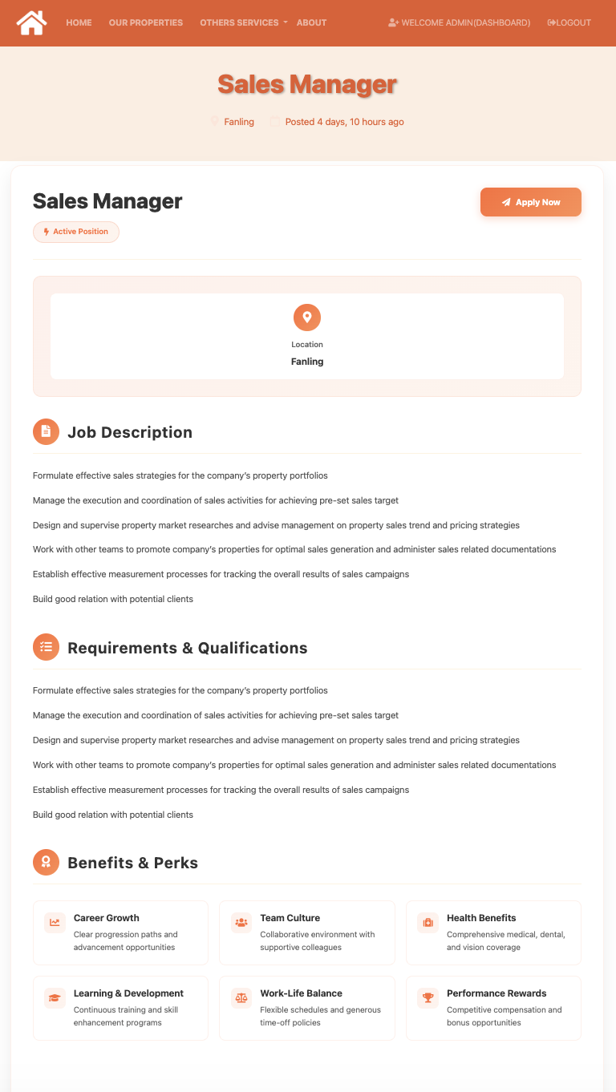
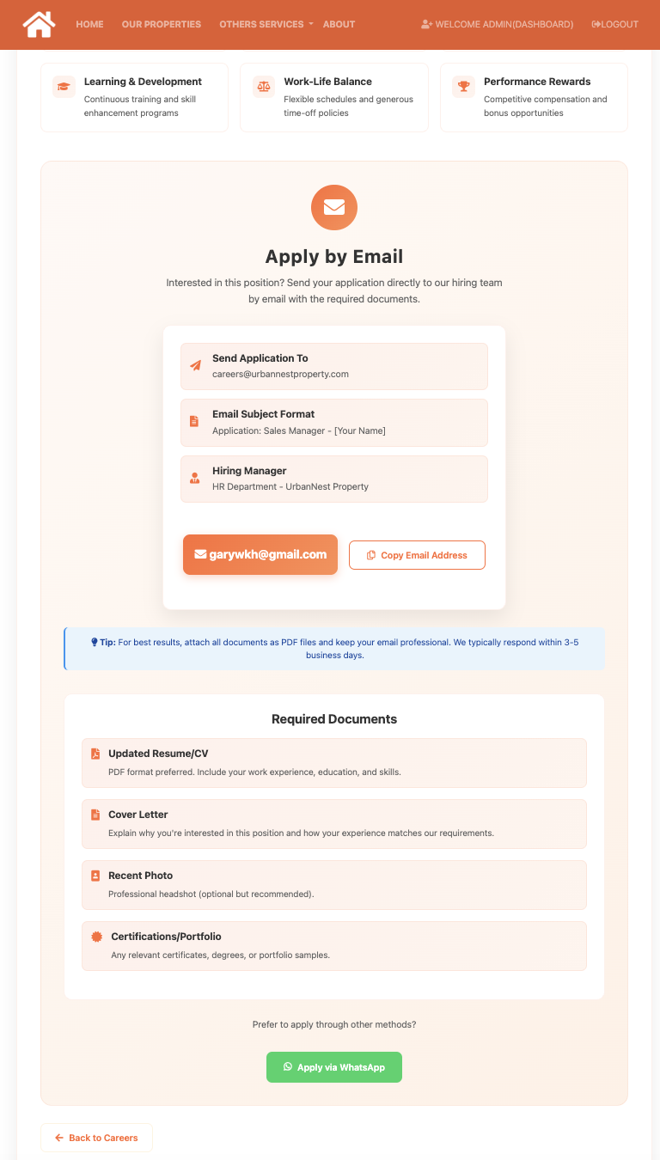
Other Services – Job Opening

Slide 26
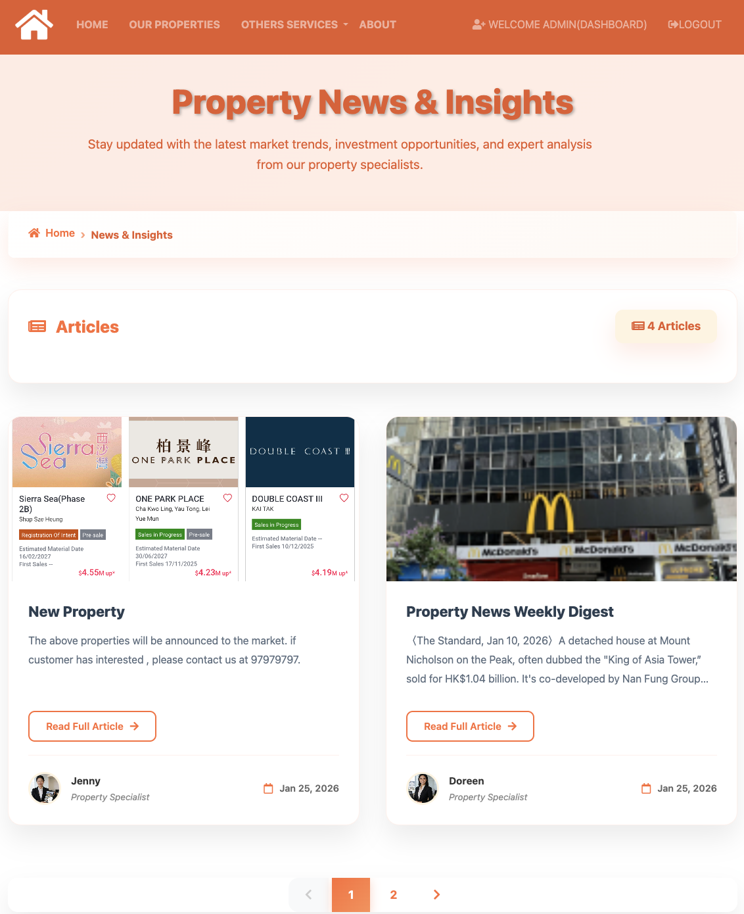
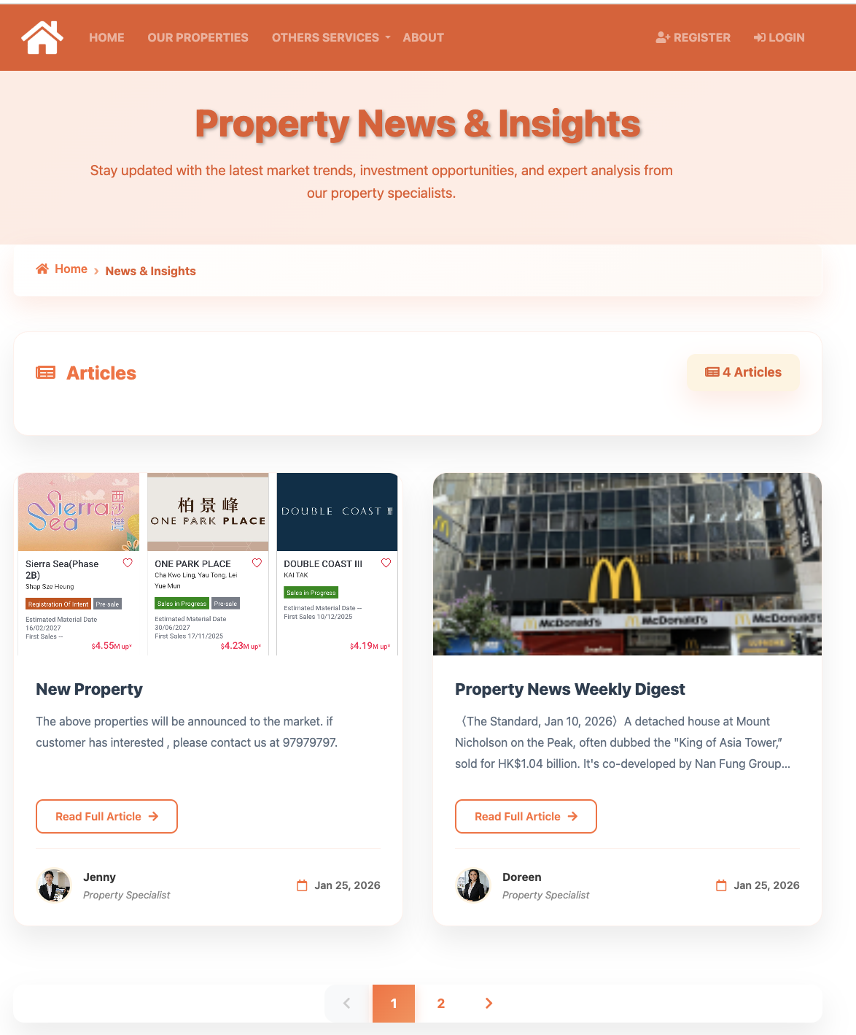
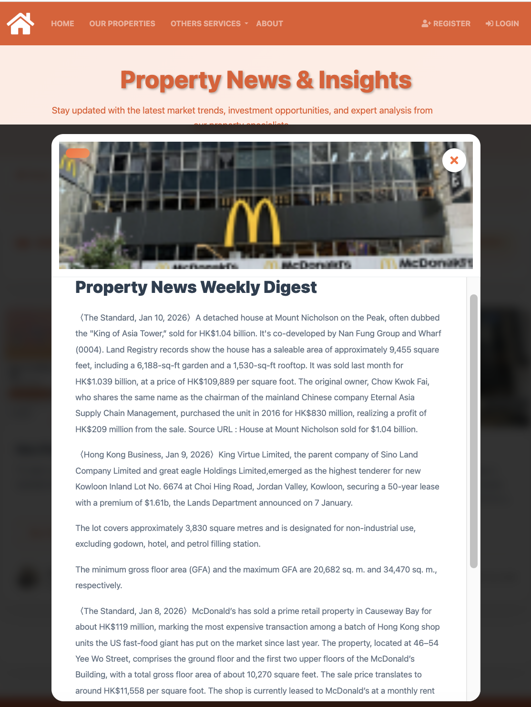
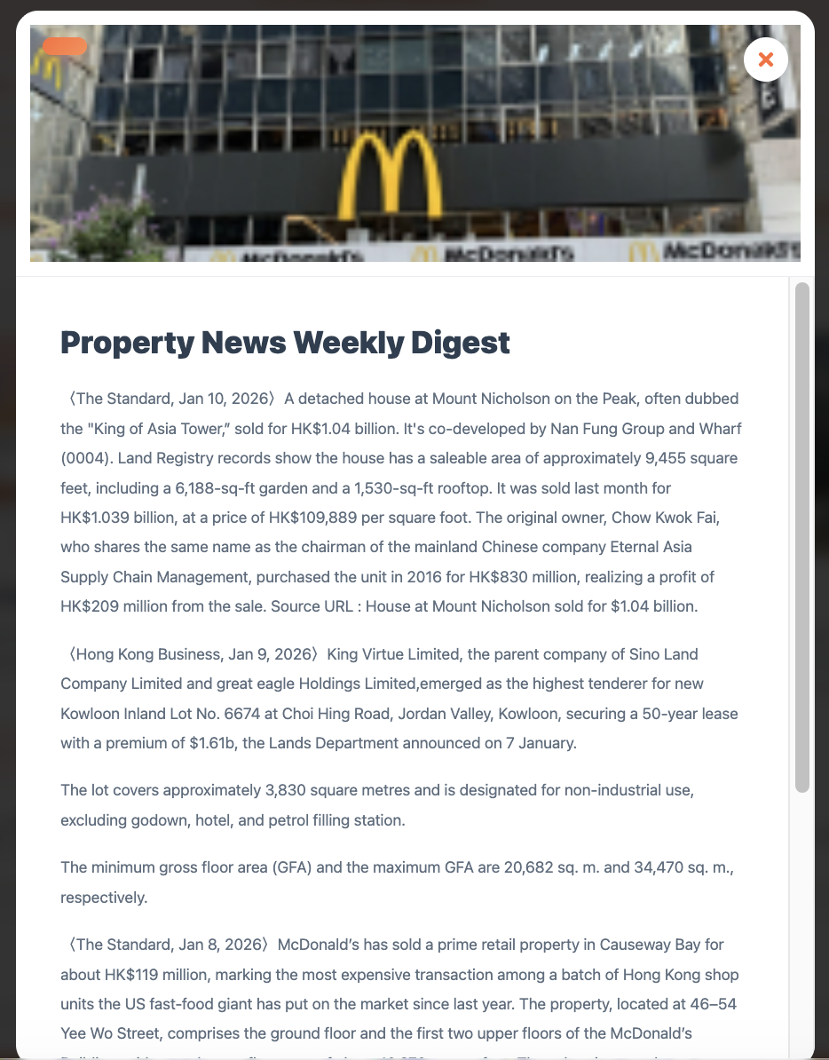
Other Services – Property News

Slide 27
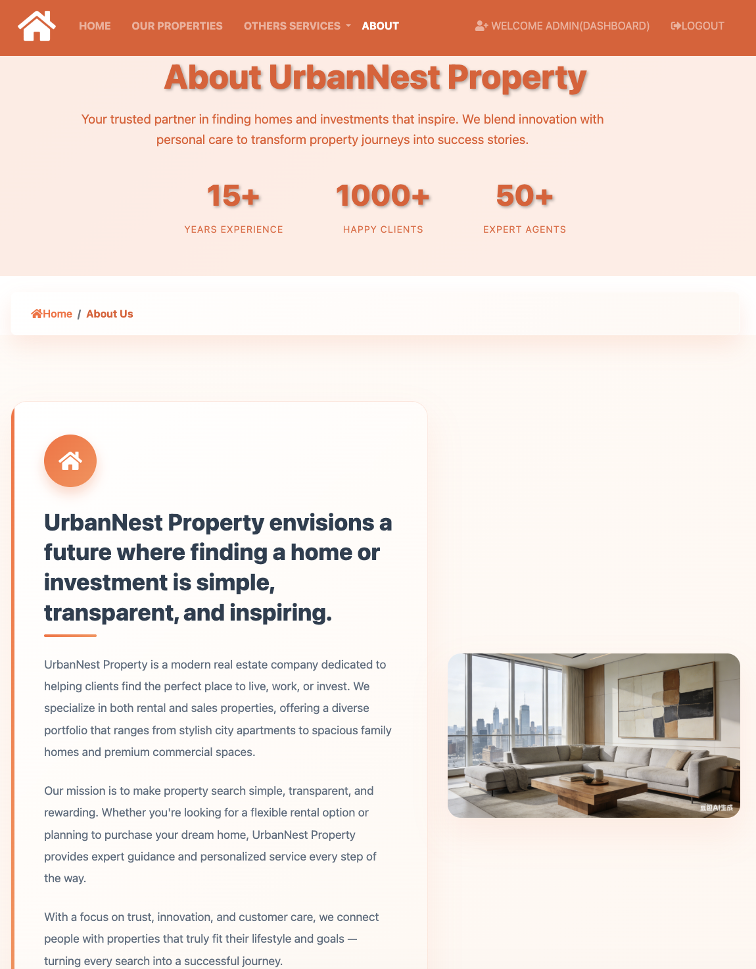





About

Slide 28




Member Register

Slide 29




Login & Dashboard & Logout

Slide 30




Reset Password 1

Slide 31




Reset Password 2

Slide 32




Reset Password 3

